Slide 1
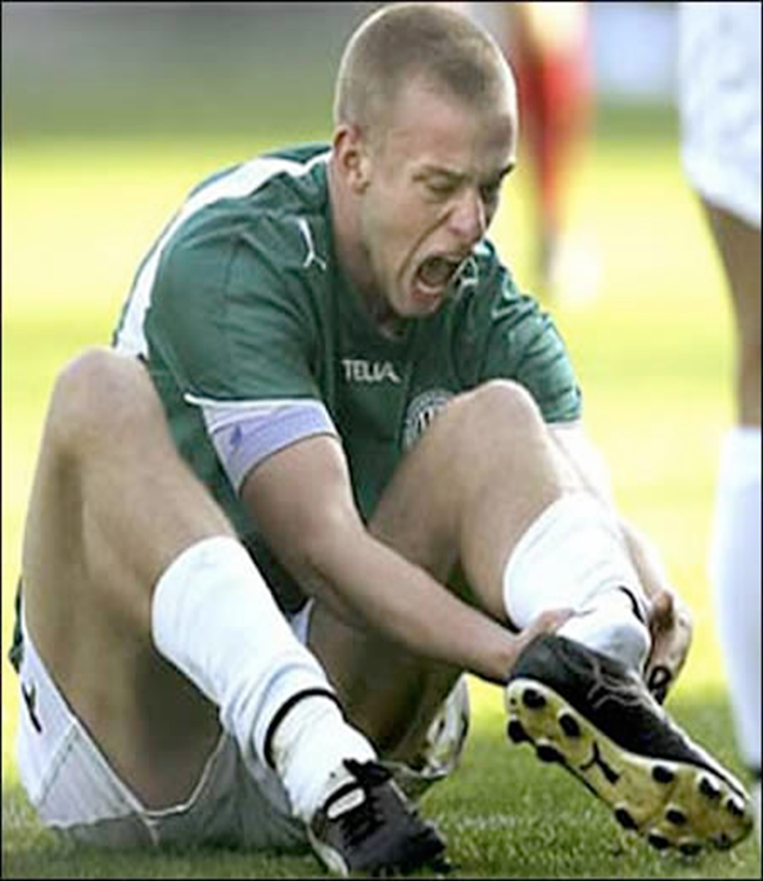

What a pain…
Updates
  Eric J. Visser

Slide 2
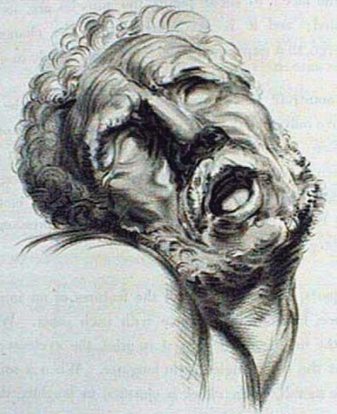

What is pain?
Pain is a highly personal, unpleasant, sensory & emotional
experience…generated by the brain…
…in situations of perceived tissue damage (threat or stress)
How do we know someone’s ‘in pain’ ?
-they tell us (verbal reports)
-observe pain behaviours (very subjective)

Slide 3
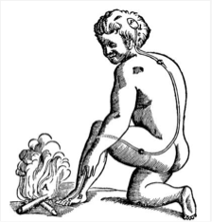
What is pain?
Pain is multi-dimensional experience moulded by…
Biological (genetic)
Psycho-social
Environmental
Pain always occurs in a context
Impacts of a person’s pain are affected by their coping

Slide 4
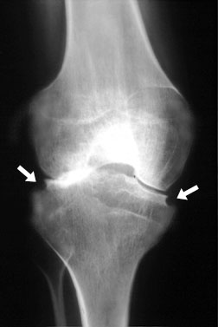
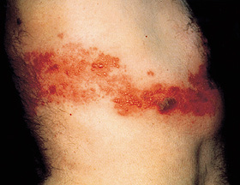

Types of pain
Nociceptive pain
-tissue damage pain
-e.g. OA knee, fracture
Neuropathic pain
-damage to sensory nervous system
-shingles
-sciatica
Regional or widespread pain
-fibromyalgia
Cancer pain

Slide 5
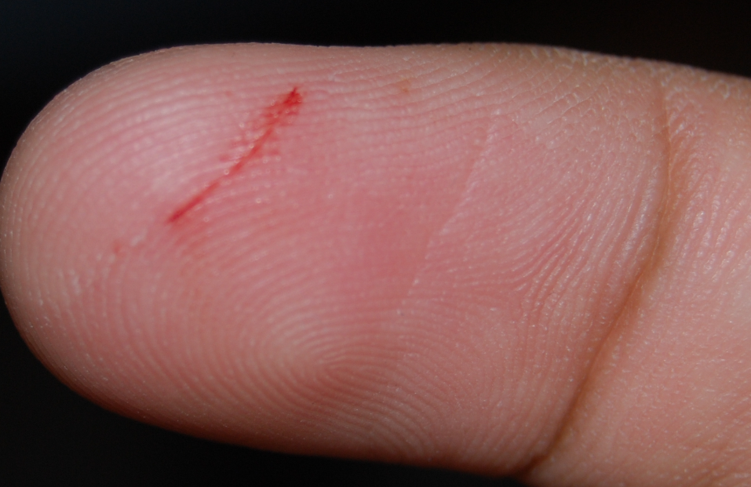
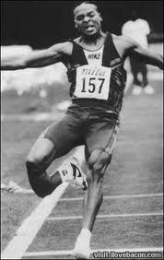
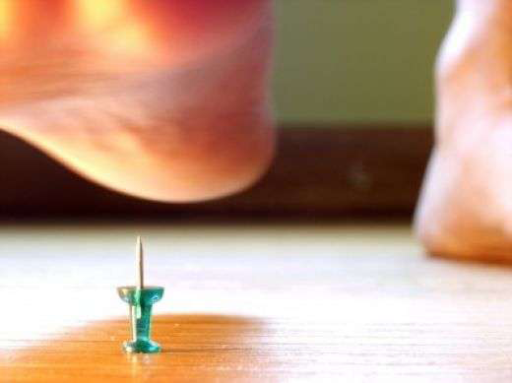
Acute Pain
Nature’s tissue-damage ‘alarm’
Nociceptive & inflammatory pain
Pain ≈ amount of tissue damage
Pain gets better as tissues heal
Protective & adaptive
Highly preserved in evolution

Slide 6
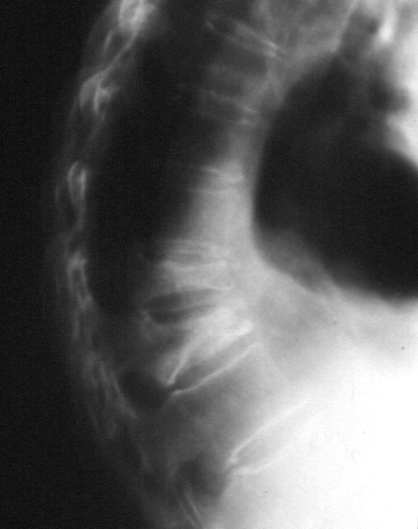
Acute Pain
5% of people > 65yoa have severe acute pain
-trauma (eg # NOF)
-osteoporotic vertebral #
-herpes zoster pain
-flare of arthritis
-acute ischemic leg pain
-post surgical pain
Cancer pain

Slide 7
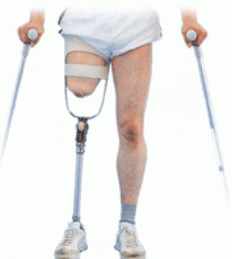
Chronic pain
Pain-alarm malfunction
Pain > time of normal tissue healing (≥ 3 months)
No protective function (mal-adaptive)
Alarm keeps ringing when there’s no emergency
Pain ≠ amount of tissue damage
Yes, you CAN experience pain without tissue damage
-Squeezing your thumb nail
-Phantom limb pain
-Back pain with a ‘normal’ MRI

Slide 8
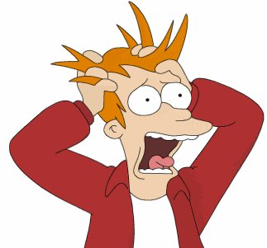
‘NASTI’ causes of pain are…
Nociception (tissue damage)
Nerve damage
Anxiety
Stress
THREAT
Injury (wounding)
What NASTI factors are driving my patient’s pain?
What seems to be threatening them?

Slide 9
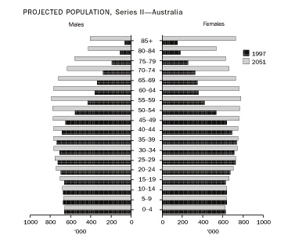
Pain in older persons
Pain is more prevalent in older persons (50%)
80% in nursing homes
Increasing problem as population ages

Slide 10
Age differences in pain perception & reporting
↓ Pain tolerance
↑ Pain threshold
young
old
young
old
Pain stimulus

Slide 11
Pain in older persons
Higher pain threshold (it takes more stimulus to trigger pain)
-old nerve fibres & brains (worn out alarm)
-silent heart attack, missed infection or fractures, cancer
Lower pain tolerance (once in pain they tolerate it less)
-old pain inhibitory systems
-psychological vulnerability (fear, confusion)
Less pain reports
FALSE: older persons experience less pain

Slide 12
Pain in older persons
Less coping reserves & resources
-psycho-social vulnerability
-depression, anxiety
-social isolation, family
-financial
Difficult rehabilitation

Slide 13
Pain assessment in older persons
Less pain reports (suffering in silence)
Less opportunity or desire to report
Vulnerable (isolation, fear etc)
Stoicism
Assessment
-pain yes/no?
-severity
-quality
-timing

Slide 14
How do we know someone’s in pain?
They tell us (self report)
-language
We observe pain behaviours
-showing others we’re in trouble
-vocalizations & facial expressions
-protective behaviours (limping, splinting, rubbing)
-escape behaviours (pacing, thrashing)
Distress behaviours (anxiety, panic, dyspnoea, confusion)

Slide 15
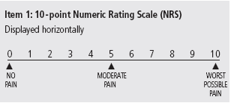
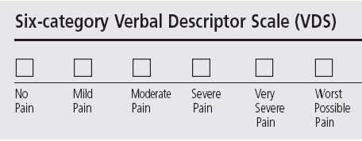
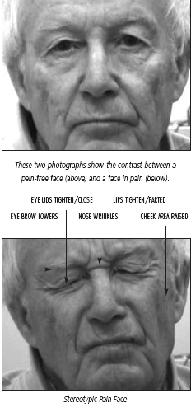
Assessing & measuring pain: tools
Verbal
-number rating scale: ‘out of ten’
-categorical
Observer-based behaviours (dementia) (4Gs)
-Grimace: facial expressions (vip)
-Groan: vocalizations
-Grapple: movements
-Grunt: physiology (breathing, sympathetic)

Slide 16
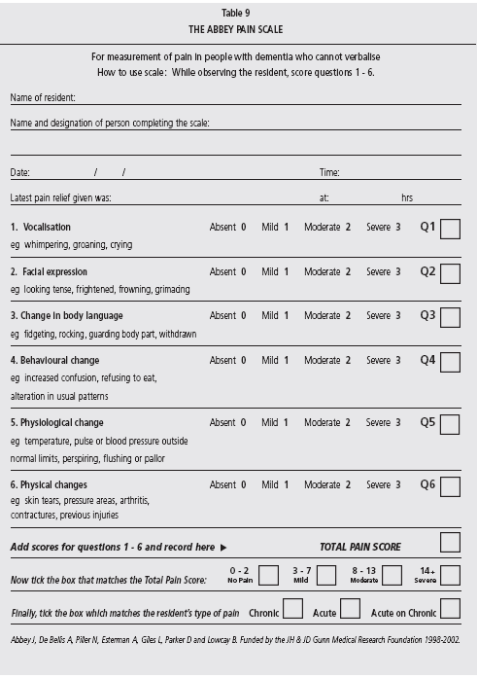
Assessing & measuring pain

Slide 17
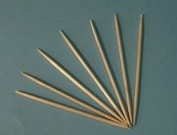
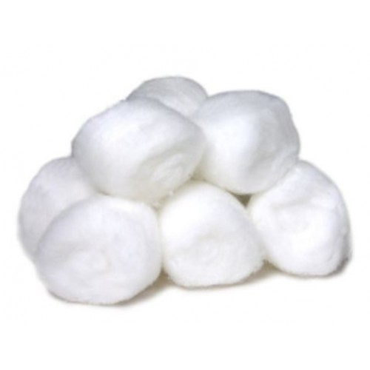

Assessing & measuring pain
Quality?
-burning, shooting, stabbing, electric shocks (neuropathic)
-colic (bladder, bowel)
Allodynia (touch pain)
Timing?
Response to analgesics?

Slide 18
Pain in older persons
Higher prevalence of pain
Less pain tolerance
More difficult to assess
Less coping reserves
More sensitive to analgesics & medications
More difficult rehabilitation

Slide 19
Dementia and pain
Commonly coexist in elderly, especially in care (40-80%).
Do they feel less pain?
No brain, no pain: ↓pain processing & perception?
-do dementia patients ‘feel’ less pain?
-infants & neonates (circumcision)
-“locked-in” & not able to report pain?
Dementia patient do experience pain.

Slide 20
Elderly patients with dementia:
Report less pain
Less autonomic response
Similar pain thresholds to other elderly
Similar ability to localize pain
Lack of self management of pain
-self report, behavioural (comfort, positioning), medications.
Increased vulnerability to ‘side effects’

Slide 21
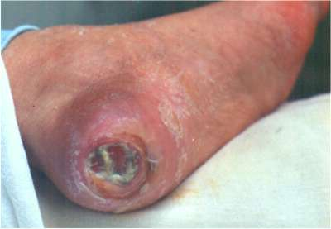
Pain in the nursing home
Jessie is an 80 year old woman with dementia
-severe generalised OA
-bed bound
-renal impairment & diabetes
Painful diabetic ulcer on R heel-daily dressings
Grimaces & cries out rolling in bed & during dressings
Not unusual behaviour for her anyway

Slide 22
What are pain issues?
Recognise, Assess, Treat (R.A.T)
She is distressed Is it pain?
-brain, fear, SOB, itch thirst, hunger, bladder, bowel, positioning?
PAIN:
-OA widespread body pain
-diabetic neuropathy (nerve pain in feet?)
-painful ulcer (dressings)
TYPE: Neuropathic & nociceptive pain
TIMING: chronic & acute (procedure)

Slide 23
Assess
Observational (4G)
-Grimace, Groan, Grapple, Grunt
-Abbey Scale
Examine the feet for neuropathic pain
Response to analgesia

Slide 24
Treat
Chronic pain (nociceptive, neuropathic pain)
-OA, painful diabetic neuropathy
Acute pain
-dressings
Physical, pharmacological, psychosocial
Physical
-comfort measures, positioning
-distraction

Slide 25
Pharmacology
What do we give?
How we give it (swallowing, spits out tablets)
Side effects (brain, kidney, bowel)
Falls risk
Pill safety: confusion, vision, overdose
Keep it simple
Less is more
Start low & go slow

Slide 26
Opioids in older persons
Older brains, livers and kidneys
More sensitive to analgesic drugs
Age is main factor affecting opioid dose
-100-age = mg iv morphine/d
10 fold variation in population to analgesic drug effects

Slide 27
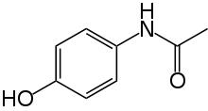
Pharmacology
Paracetamol (panadol ‘rapid’ as good, better?)
NSAIDs (NO)
Pregabalin (25 mg, capsules) (neuropathic pain)
-builds up in renal impairment
-sedation, falls risk, confusion, fluid retention
Duloxetine
-pharmacy compound low doses
Amitriptyline (side effects)

Slide 28
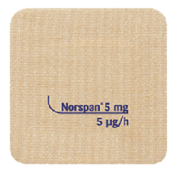
Pharmacology
Norspan patch (Buprenorphine)
Safer
Less respiratory depression
No renal build-up
Swallowing, gut (constipation)
Constant analgesia
Lowest possible dose
Patch problems: fiddling, heat, adhesion
Rash (steroid cream)
Slow onset & offset

Slide 29
Pharmacology
Targin
Oxycodone/naloxone capsule 2:1
Less constipation
Lowest doses: 2.5/1.25 mg
Oxycodone IR (endone, elixir)

Slide 30
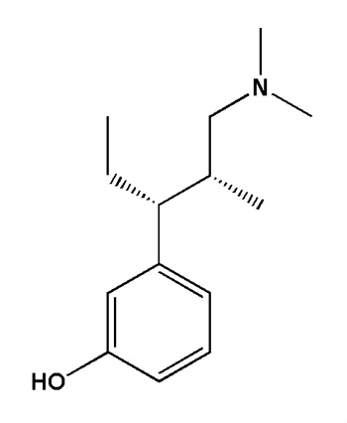
Pharmacology
Tapentadol (Palexia)
Weak opioid & nor adrenaline analgesic
Good analgesia: neuropathic pain
Less side effects than tramadol
Less constipation, nausea
50 mg may be too much in older patients
Tramadol
Zaldiar (tramadol 37.5 + paracetamol 325 mg)

Slide 31
Dressings pain
Wound care, nursing
Give background analgesia
Analgesia before dressing
-oxycodone IR 45 minutes before
Topical agents
-1% lignocaine (up to 15 mls 2 x daily)
EMLA cream for 1 hour prior to debridement
Entonox 50/50 (vitamins)
Inhaled anaesthetic agents on tissue?

Slide 32

Handy hints: any acute pain….
ALWAYS consider red flags (T.I.N.T)
Tumour
Infection/Inflammation
Neurological
Trauma
Cancer
Steroids
Fall
Osteoporosis

Slide 33
Handy hints
Osteoporotic vertebral fracture pain
It’s a red flag
Difficult to manage
Physical therapies
-back brace
-TENS machine?
Pharmacological
-multimodal analgesia (opioids)
-salmon calcitonin injections 100 IU daily
-bisphosphonate
Facet joint procedures
Vertebral cement injection

Slide 34
Key management areas for OA knee
Multimodal
Multidisciplinary
Rehabilitation
Weight reduction (OA knee, females) ++ (Cochrane)
Patient education & information +?(Review)

Slide 35
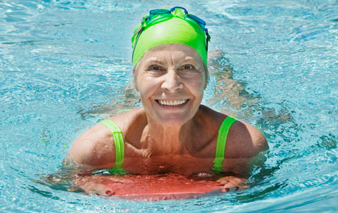
Exercise and physical therapies
General exercise (incl. water) + (Cochrane)
Tai Chi + (Cochrane)
Quads strengthening + (Cochrane)
Podiatry, orthotics (knee, hip) + (Level I)
Walking stick (knee) + (Level I)

Slide 36
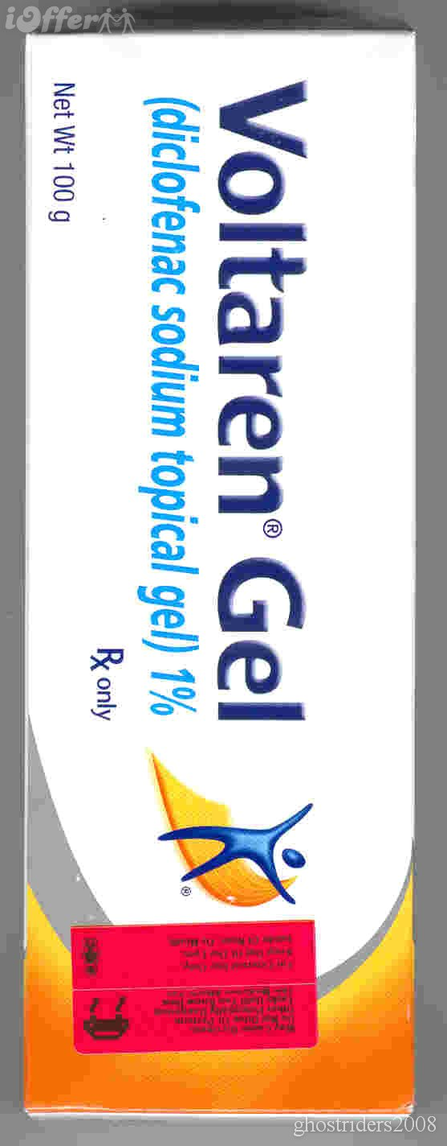
Analgesia
Paracetamol -? (Level I)
Tramadol ++ (Cochrane)
Combination paracetamol-tramadol ++ (Level I)
Tapentadol SR + (RCT)
Norspan, Targin
Duloxetine + (RCT)
Topical NSAIDs capsaicin (hand, knee) + (RCT)

Slide 37
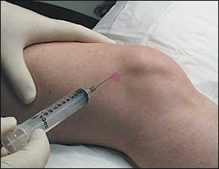
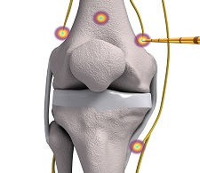
Procedures
I/A steroid injection + (I)
I/A visco-supplement injections +? (I)
Genicular nerve blocks/radiofrequency? ?
Saphenous nerve branch blocks

Slide 38
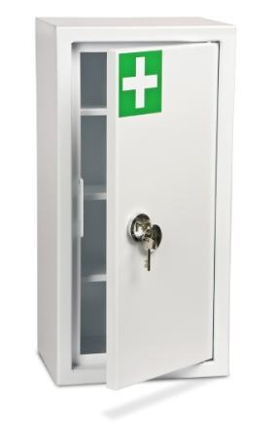
Handy hints
Analgesic drug cupboard
Paracetamol
Norspan
Targin
Tramadol (drops, Zaldiar, SR)
Oxycodone IR
Pregabalin
Duloxetine
Topical NSAIDs
Menthol & capsaicin creams
Lignocaine patches

Slide 39
Pain in older persons
Higher prevalence of pain
Less pain tolerance
More difficult to assess (dementia, 4Gs)
Less coping reserves
-respite or ‘social’ admissions
More sensitive to analgesics & medications
Difficult rehabilitation

Slide 40

Thank you

Slide 41
Central Sensitization
‘Pain’ signal (nociceptive) amplification
‘Increased nociceptive output for a given nociceptive input’
A true amplifier effect
‘Wind-up’
Capacitance effect
pain signal ‘memory’
NMDA
1 1 1 1 1 1 1 1 1 1 1 1 1 3Hz
lllllllllllllllllllll 50 Hz
Dorsal horn
Makes sense for ‘alarm’ to ‘ring’ louder so we don’t ignore it...
Smoke detector
Notes:
41

Slide 42
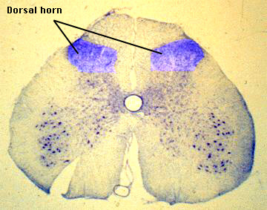
Dorsal horn
Nociceptive signal processing (modulation)

Slide 43
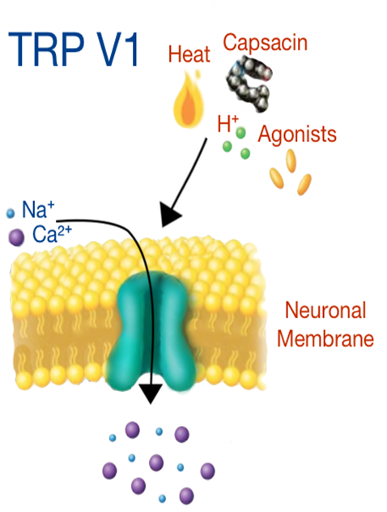


Nociceptive pathways
transmission
Descending inhibition
‘signal inhibition’
DRG
Aδ & C fibres
Central sensitization
‘signal amplification’
transduction
transmission
modulation
Dorsal horn

Slide 44
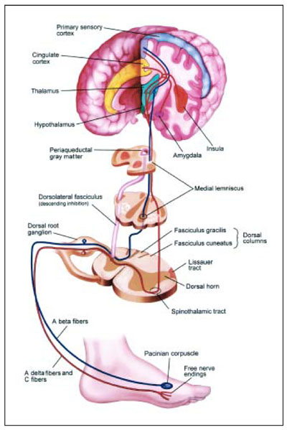
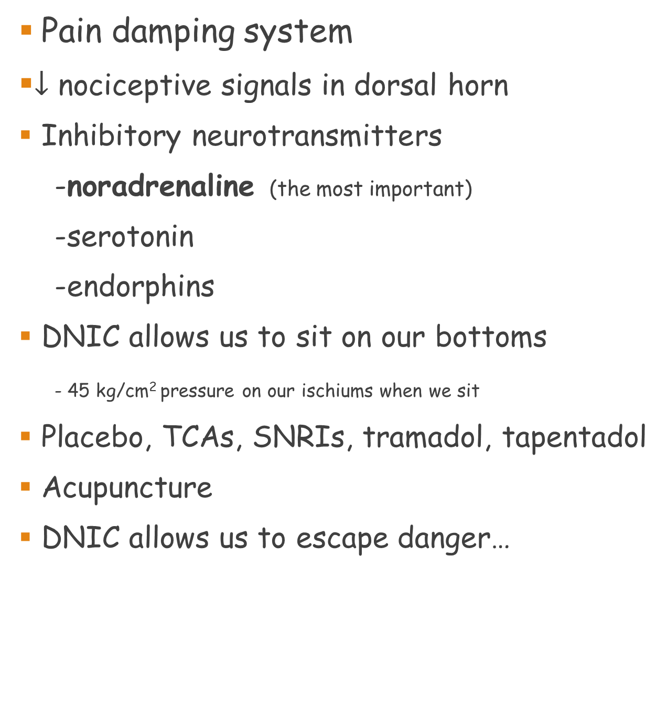
Diffuse Noxious Inhibitory Control
Conditioned Pain Modulation
Descending nociceptive inhibitory system
Pain damping system
$↓$ nociceptive signals in dorsal horn
Inhibitory neurotransmitters
-noradrenaline (the most important)
-serotonin
-endorphins
DNIC allows us to sit on our bottoms
- 45 kg/cm² pressure on our ischiums when we sit
Placebo, TCAs, SNRIs, tramadol, tapentadol
Acupuncture
DNIC allows us to escape danger…

Slide 45
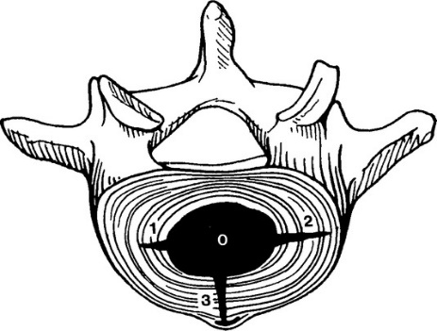
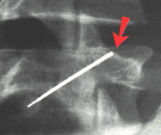
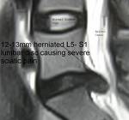
Spinal pain
Non specific in 90% (no pain generator is identified)
CLBP Neck pain
TINT (red flags) 5% 5%
Tumour, Infection/Inflammation, Neurological, Trauma
Disc 40% 20%
Facet 20% 40%
Radiculopathy 10% 10%

Slide 46
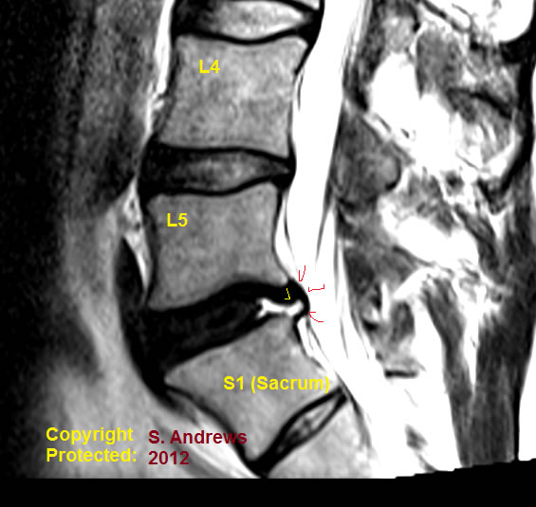

Discogenic spinal pain
40% CLBP, 20% neck pain
Annular disruption
MRI, discography
Can’t do much about it: ‘Blocks’ don’t work
Spinal fusion: 5 years, no difference c/w usual care

Slide 47
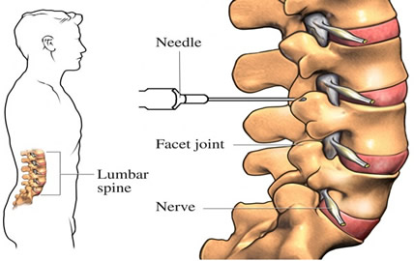
Lumbar facet joints
Injections & ‘rhizotomies’
CLBP: 20-40%
FJI’s don’t work well (NNT = 10)
A bit better if >60 (NNT = 4)
Ignore imaging: just choose L4/5 & L5/S1
Good FJI response → RF facet neurotomies (‘rhizotomies’)

Slide 48
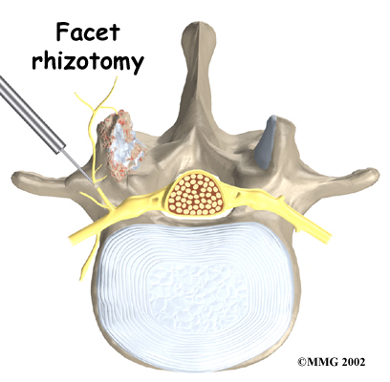
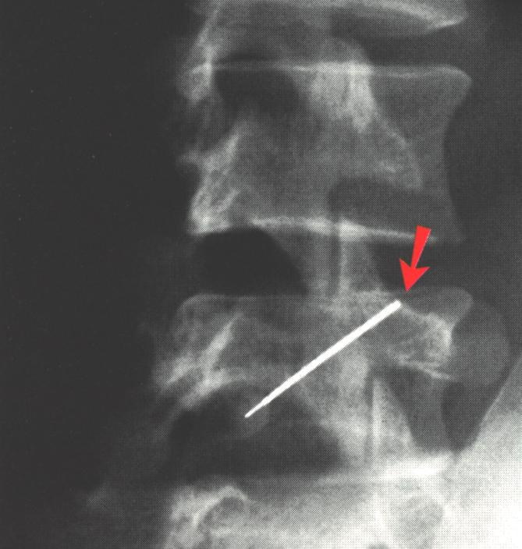
RF medial branch neurotomies (rhizotomies)
NNT= 4

Slide 49
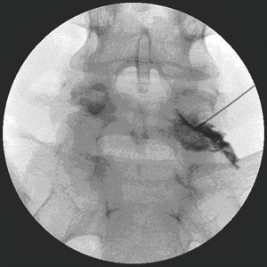
Radicular leg pain
Transforaminal epidural steroid injection
Not a nerve root sleeve!
NNT= 4
Never in the neck!

