Slide 1
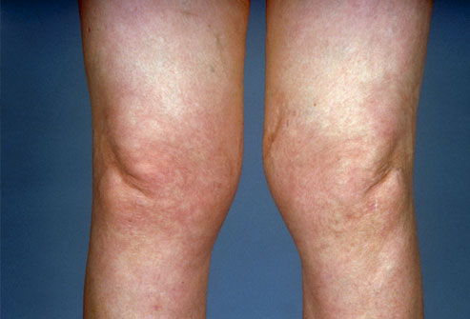
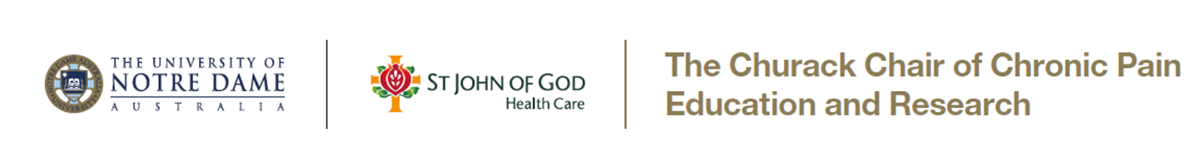
Chronic Pain Management in OA knee
  Eric J. Visser

Slide 2
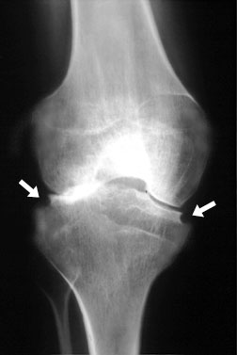
Management of OA knee: pain & function
OA: most common cause of chronic pain
Chronic disease management approach
Manage pain & disability
Multidisciplinary & multi-modal
Rehabilitation

Slide 3
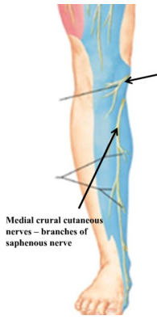
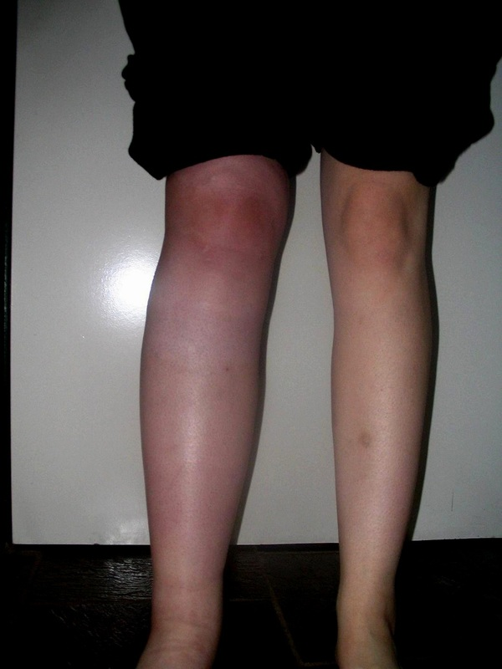
Not all knee pain is from OA joint
10-20% neuropathic pain component
Infra patellar branch neuralgia
10% CRPS
15% chronic pain after TKR
Risk factors
-long-standing knee pain
-re-operation
-high acute pain scores
-yellow flags

Slide 4
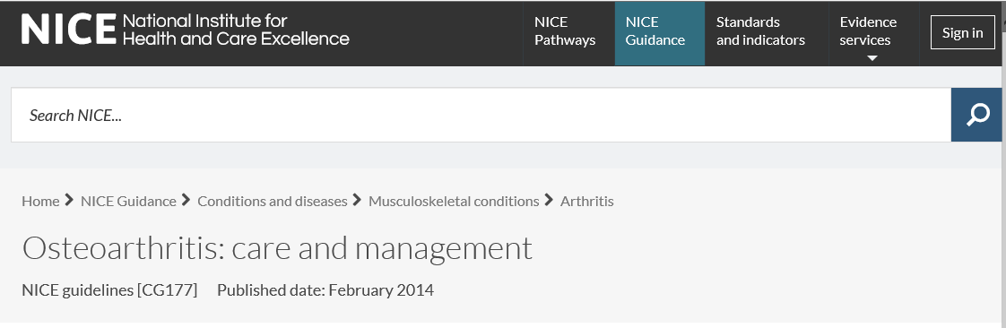
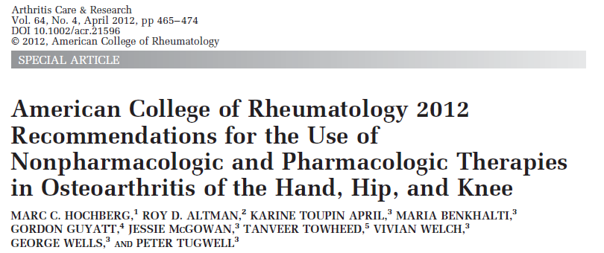
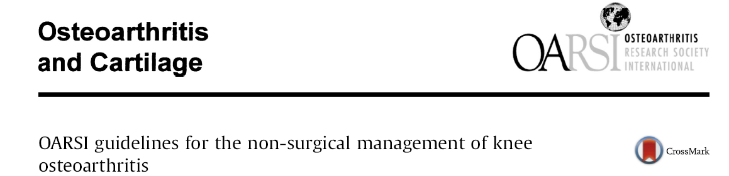


Slide 5



Key management areas for OA knee
Exclude red flags (T.I.N.T)
-Tumour, Infection/Inflammation, Neurological, Trauma
Consider yellow flags (C.H.A.M.P.S)
-catastrophizing, anxiety, stress
Functional impacts
-self care
-work
Pain management in the elderly

Slide 6
Key management areas for OA knee
Weight reduction (OA knee, females) ++ (Cochrane)
Patient education & information +? (Review)
Exercise & physical therapies
Disease-modifying therapies
Analgesia
Procedures & surgery

Slide 7
Exercise and physical therapies
General exercise (incl. water) + (Cochrane)
Tai Chi + (Cochrane)
Quads strengthening + (Cochrane)
Podiatry, orthotics (knee, hip) + (Level I)
Walking stick (knee) + (Level I)
Acupuncture +? (Cochrane)
TENS -? (Cochrane)
Knee splints ?

Slide 8
Disease modifying drugs
Intra articular steroids (NNT 5; short term) + (Cochrane)
I/A viscosupplement inj (hyaluronan) (NNT 7) +? (Cochrane)
Vitamin C (preventing CRPS) +? (Level I)
Glucosamine &/or chondroitin - (Cochrane)
Fish oil, vitamins & supplements - (RCT)
Bisphosphonates - (RCT)

Slide 9
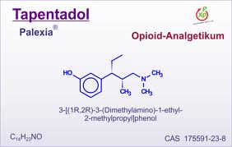
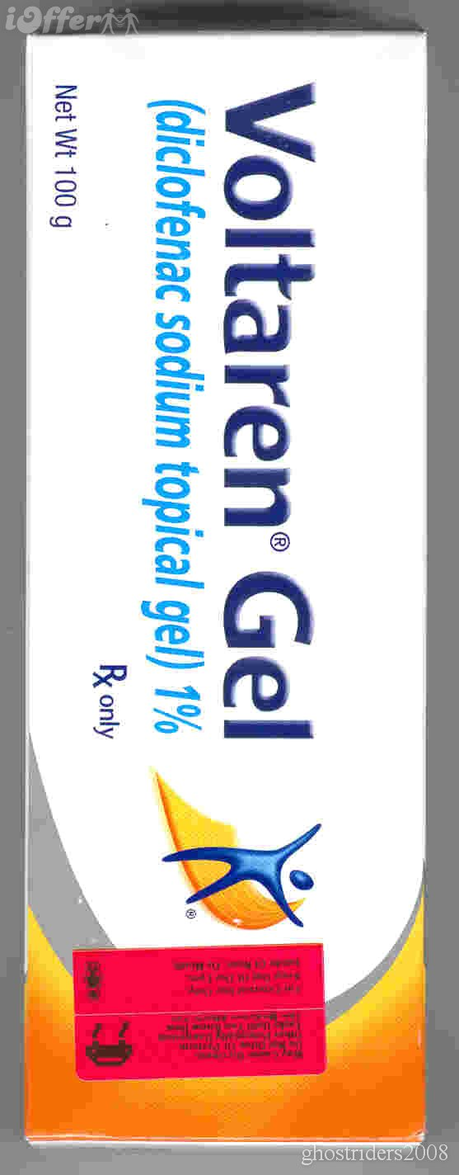
Analgesia
Paracetamol -? (Level I)
Tramadol ++ (Cochrane)
Combination paracetamol-tramadol ++ (Level I)
Tapentadol SR + (RCT)
Duloxetine + (RCT)
Topical NSAIDs (hand, knee) + (RCT)
Topical capsaicin (hand, knee) + (RCT)
Machado GC et al. Efficacy and safety of paracetamol for spinal pain and osteoarthritis: systematic review and meta-analysis of randomised placebo controlled trials. BMJ 2015.

Slide 10
Analgesia: NSAIDs & COXibs
Effective ++ (Cochrane)
Consider risks vs benefits
Gastrointestinal (celecoxib; add PPI) ++ (meta-analysis)
CVS (celecoxib or naproxen) ++ (meta-analysis)
Renal risk (all the same)
NSAIDs: best for short term for pain ‘flare ups’

Slide 11

Opioids
An inconvenient truth
Not great for chronic pain
NNT 4-8, VAS 15/100, 30% rule
Niche in joint pain (≥ 65)
3Ts: tramadol, tapentadol, transdermal buprenorphine
Opioid analgesia is an ongoing clinical trial

Slide 12
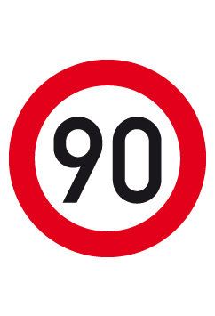
Opioid ceiling ≤ 90 mg oral morphine/eq per day
≤ 90 days

Slide 13
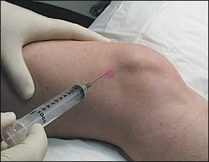
Procedures
I/A steroid +? (Cochrane)
I/A viscosupp. injections +? (Cochrane)
Genicular nerve blocks/radiofrequency +? (RCT)
Saphenous nerve branch blocks ?
Joint lavage - (Cochrane)
I/A stem cells, platelet-rich plasma, Botox ??

Slide 14
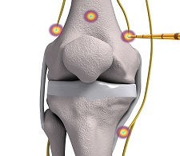
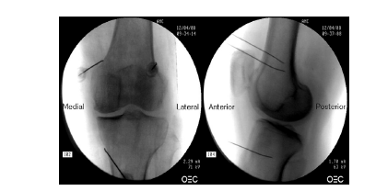
Knee radiofrequency

Slide 15
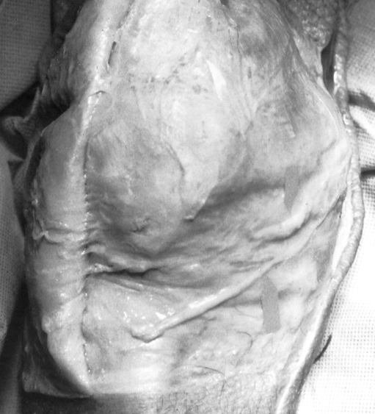
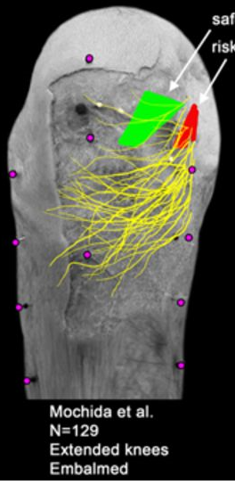
Infrapatellar branch of saphenous nerve
Gonalgia paresthetica
Altered sensation
Allodynia
De novo knee pain
Post surgery
Arthroscopy ports
LA injection
Saphenous block

Slide 16
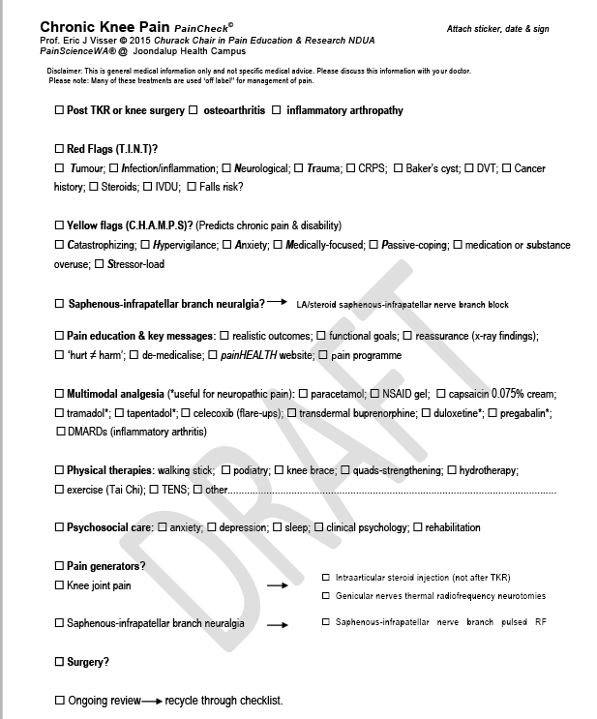

Slide 17
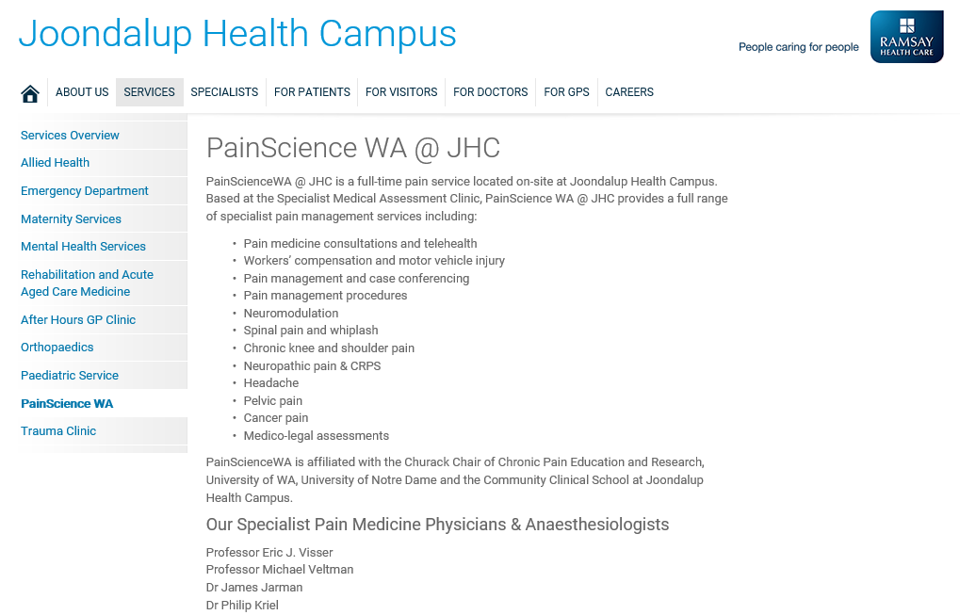
Thank you

