Slide 1
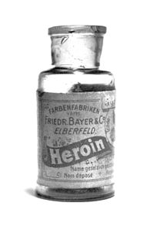
Opioids for chronic non-cancer pain? Which ones.....if any?
Eric J. Visser
Professor and Churack Chair, UNDA
Specialist pain medicine physician and anaesthesiologist

Slide 2
Do opioids work for chronic pain?
No, not that well (Level I)
Especially not for LBP in < 60s
NNT = 4
30% reduction in pain score (1.5/10) on average
60% adverse effects (NNH = 4); 30% stop taking them within weeks
Only 30% are still taking opioids at 12M

Slide 3
What are the adverse effects of opioids?
Classical side effects (respiratory, sedation, dizziness, nausea, constipation)
Opioid-induced hyperalgesia & tolerance (pain gets worse)
Endocrinopathy (testosterone, osteoporosis)
Cortical changes on fMRI (cognitive, anxiety, mood, motivation)
Immune suppression
Increased mortality

Slide 4
Opioid dose escalation (over-use) Why do opioid doses increase over time?
The good news.....
Dose escalation is the exception rather than the rule (only in 30%)
Why do doses go up?...
-Chemical coping
-Disease progression (neuropathic pain) or new disease
-Neuro-adaptation (hyperalgesia, tolerance)
-Addiction (15%)
-Diversion
-Prescriber practice

Slide 5
Selecting-out ‘poor copers’ & treating their distress with opioids
Chemical coping
Distress
Opioids
Lifestyle
Dysfunction
Dyscopia
Chemical coping

Slide 6
How much is enough? ‘Ceiling dose’
90 mg oral morphine equivalents per day is plenty!
If >200 mg oral morphine/d
-3 x increase overdose deaths
-Premature all-cause death
-Major psychosocial issues

Slide 7
If opioid analgesia is not working.....
Opioid rotation
Taper and cease
10% per fortnight

Slide 8
Opioid analgesia
All opioid prescribing for chronic pain is an ongoing clinical trial
Measure end points (function)
Don’t ‘’set-and-forget’’ prescribe
Review ever 3 months
Only diamonds are forever, not opioids!

Slide 9
If opioid analgesia is not working.....
It’s OK to say no and to taper and cease
‘I can’t safely prescribe this anymore’
‘Your pain does not respond to opioid medications’
‘Just like some infections don’t respond to antibiotics.....
Some pain does not respond to pain killers’

Slide 10
Which opioids should we use? Tramadol
1/3rd opioid, 1/3rd nor-adrenaline, 1/3rd serotonin
Good for neuropathic pain (Level I)
Less addiction (S4), tolerance, hyperalgesia, withdrawal
Less respiratory depression
Less bowel dysfunction
Can combine with some antidepressants (serotonin syndrome, 1/7000)

Slide 11
Tapentadol (SR)
½ opioid, ½ nor-adrenaline (no serotonin)
Good for neuropathic pain and tissue injury pain (mixed pain)
½ the potency of oral morphine
Less addiction (S8)
Less bowel dysfunction
Can combine with some antidepressants, or other opioids

Slide 12
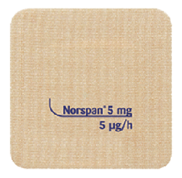
Transdermal buprenorphine patch
Mu partial agonist, kappa antagonist
No ceiling effect for analgesia
Use it like any other opioid
Safer respiratory profile
Safer renal profile (no accumulation)
Lower dose escalation rate
Better dose control....only 1 patch per week

Slide 13
Summary: Opioids for chronic pain
They don’t ‘work’ that well: NNT = 4 (NNH = 4) (Level I)
‘Work’ better in over 60s (more side effects)
Avoid in NSLBP, headache, fibromyalgia, abdominal pain (Level I)
Opioid prescribing is an ongoing therapeutic trial
Ceiling dose ≤90 mg oral morphine equivalents/day
3 Ts: tramadol, tapentadol SR or transdermal buprenorphine

Slide 14
Thank you

