Slide 1
Fibromyalgia
(Chronic Widespread Pain)
Dr. Dana Halmagiu
Anaesthetist
Pain Fellow

Slide 2
Fibromyalgia Meaning
Latin : fibra = fibre
Greek : myos = muscle
Greek : algos = pain
Syndrome rather than disease
as there is no clear evidence of a structural organ damage underlying
But
unknown etiology, heterogeneous pathogenesis & defined phenotype
So
FIBROMYALGIA SYNDROME(FMS)

Slide 3
Historically
Chronic wide spread pain described since the 1800’s
Previous names:
Muscular rheumatism
Fibrositis (Gowers 1904)
Psychogenic rheumatism
Neurasthenia
Now: Fibromyalgia (since 1976)

Slide 4
Fibromyalgia Syndrome (FMS)
3% of the population
3 x more women
Occurs at any age, but most frequently between
30-60 years
More common:
  family history of chronic pain
  patients with chronic pain (IBS,CLBP, RA…)
  patients with anxiety

Slide 5
What is FMS?
Neuro-immune system dysfunction
Endocrine & autonomic nervous system dysfunction
A PAIN PROCESSING PROBLEM
“Sickness response”
“Dose of flu that does not go away”
“Aching all over and too tired to think”

Slide 6
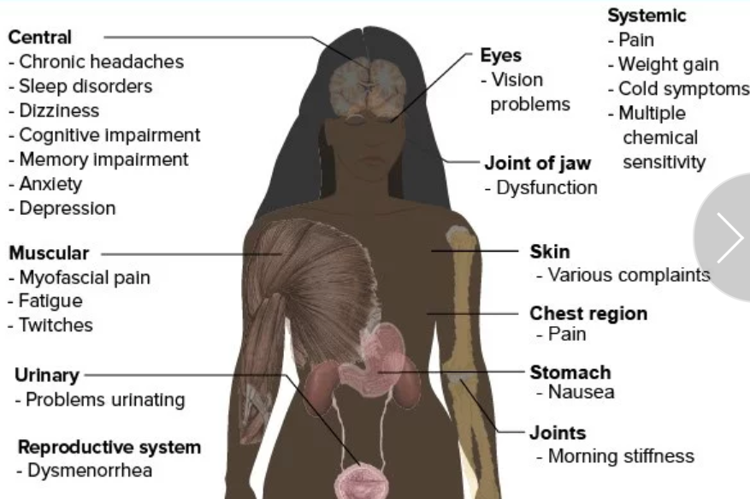
Symptoms of FMS

Slide 7
Coexisting Syndromes
GI - IBS - non-ulcer dyspepsia Gynae - Premenstrual syndrome - Chronic pelvic pain Rheumatology - Fibromyalgia Cardiology - Atypical non cardiac CP Respiratory - Hyperventilation syndrome | Infectious - Chronic fatigue syndrome Neurology - Tension headaches Dental - TM joint dysfunction - Atypical facial pain ENT - Globus syndrome Allergy - Multiple chemical sensitivities
Notes:
(A spectrum of similar conditions)

Slide 8
Triggers of FMS
Injuries
  “whiplash”, surgery, trauma
Viral infections
  Ross River virus, glandular fever
Illnesses
  cancer, rheumatoid arthritis
Environmental factors
  chemicals, toxins
Psychological & social stress
  childhood abuse or illness, stress, military service

Slide 9
Pathophysiological Abnormalities
Central Processes:
- Dysregulation of dopaminergic neurotransmission
- Increased sensitivity to NMDA receptors
Dysfunction of hypothalamic-pituitary axis
Biochemical Abnormalities:
High substance P levels in spinal fluid
Increased nerve growth factor in spinal fluid
Low growth hormone levels
Low ATP levels in red cells
Low serotonin levels

Slide 10
Genes implicated in FMS
Candidate Genes | Possible Mechanism
COMT (catechol O methyl transferase) | Catecholamine metabolism
ADRB2 (beta 2 adrenergic receptor) | Alteration of sympathetic activity
HTR2A(5 hydroxytryptamine receptor 2 A | Alteration of serotoninergic function
SLC6A4 (sodium dependent serotonin transporter) | Alteration of serotoninergic function
Dopamine D4 receptor exon III repeat polymorphism | Alteration of dopaminergic function
GCH1 | Alteration of BH4 function (tetrahydrobiopterin /NO)
TAAR1 | Modulating activity of dopaminergic receptors
CNR1 | Cannabinoid receptor
RGS4 | Protein G signaling
GRIA4 | AMPA sensitive, glutamate receptor subunit 4
HLA/MHC | Immune response
MicroRNA | Post transcriptionally inhibit gene expression

Slide 11
An Evolving Paradigm
FIBROMYALGIA(FMS)
is
A MALADAPTIVE SOMATIC RESPONSE
to
THE CUMULATIVE EFFECTS
of
PHYSICAL &/or MENTAL STRESS
in
THE GENETICALLY PREDISPOSED
(~50% heritability)

Slide 12
2010 FMS Diagnostic Criteria ACR
(American College of Rheumatology)

Slide 13
Bio-Psycho-Social?
Or
Psycho-Socio-Biological?

Slide 14
Treatment
Non - pharmacological
  Education
  Encouragement
  Psychological/Psychiatric
  Physical therapies
  Exercise program
  Regular monitoring/follow-up
Pharmacological
  Low dose TCA
  SNRI, sedatives / hypnotics
  Analgesics (tramadol)
  Antiepileptics
  Neuroimmune and glial modulators:
    melatonin, minocycline, metformin, naltrexone
Notes:
Multimodal and multidisciplinary as you would expect with a multisystem disorder

Slide 15
Management Key Points
Multimodal - Multidisciplinary
Patient tailored approach
Symptom-based management
  Non-pharmacologic & pharmacologic strategies
Aim to
  ↓ symptoms
  Maintain / improve function

Slide 16
Management Key Points
Self-management strategies are imperative
Internal locus of control
  Patient active participant!!
  Multimodal approach
  Realistic goals, coping strategies
  Pacing, but continue normal life

Slide 17
What is Self Management?
“ The individual’s ability to manage the symptoms, treatment, physical and social consequences & lifestyle changes inherent in living with a chronic condition”
Barlow 2002

Slide 18
Chronic Pain Self-Management
Based on the Stanford Chronic Disease Self-Management Program
Active is better than passive
Keep Wellness in the foreground (no more PAIN DIARIES!)
The patient is the “expert” who works in partnership with their GP
The patient takes responsibility for their own health, uses their mind for pain management, uses pacing, problem-solving, action plans and goal-setting

Slide 19
Non Pharma Treatments
Exercise - best available evidence
  aerobics, water based, stretching, etc.
Physiotherapy
Psychotherapy
CAM (Complementary & Alternative Medicine)
  Insufficient evidence
  Encourage disclosure of use

Slide 20
Movement is Key
Tai Chi
  Wang et al. NEJM 2010: 363 (8): 744
Qi Gong (Mindful Movement/Meditative Exercise)
  Sawynok et al. Evidence Based Complementary and Alternative Medicine. 2013
Aerobics & Water exercise
  Mannerkorpi & Henriksen. 2007. Best Practice & Clinical Research Rheumatology. 21:513
Yoga
  Carson et al. 2010. Pain 151: 530

Slide 21
Mindfulness Meditation
Develop nonjudgmental awareness of moment-to-moment experience within a context of openness, kindness, tolerance & acceptance of perceptible sensory, mental and emotional phenomena
Can improve coping & health-related quality of life in many chronic conditions including chronic pain & FMS

Slide 22
Pharma Treatments
No perfect drug
Lowest dose, gradual increase
Expect only a modest response
Consider combination drugs
Consider drug mechanisms
Constant evaluation re: risk vs. benefit

Slide 23
Caution
Change one thing at a time
Side effects often similar to symptoms of FMS
Caution re dependency on pills that foster “passivity”

Slide 24
Symptom Based Management
Pain
  Analgesics (simple, NSAIDs, weak opioids)
  Anticonvulsants (gabapentinoids)
  Antidepressants
  Opioids - AVOID
Sleep
  Gabapentinoids
  TCA’s
  Atypical agents…Quetiapine Mirtazapine
  Benzodiazepines?? Cannabinoids??? - AVOID
Mood
  Your best choice depending on patient
Fatigue
  Bupropion, methylphenidate

Slide 25
How Low Can You Go?
Amitriptyline: 10 mg at bedtime*
Duloxetine: 30 mg morning with food
Pregabalin: 25 – 50 mg with supper*
Gabapentin: 100 mg with supper
Consider polypharmacy (but no evidence)
*I start even lower

Slide 26
Neuro-immune and glial modulators
Minocycline - anti-inflammatory on microglia
Metformin - AMPK activator
Naltrexone(LDN) - anti-inflammatory on microglia
Melatonin - for better sleep? Anti-nociceptive?
Notes:
AMP activated protein kinase ,

Slide 27
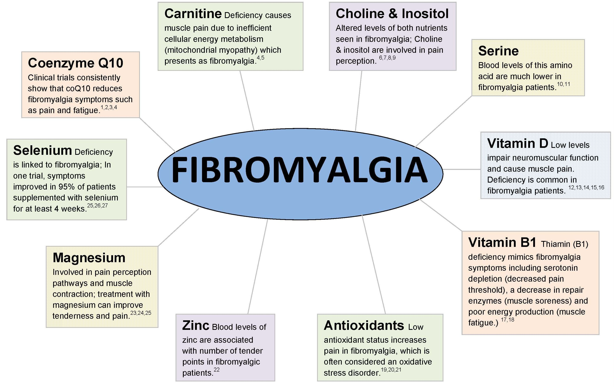
A Place for Supplements?

Slide 28
Patients Choice of Medications
Internet survey of 2500 FMS patients USA
Most common medications
  Acetaminophen, ibuprofen, aspirin, naproxen, cyclobenzaprine, amitriptyline
Perceived as best
  hydrocodone, oxycodone, aprazolam, clonazepam,
  zolpidem, cyclobenzaprine

Slide 29
When Do Things Go Wrong?
Doctor
  Wrong diagnosis
  Not attending to mood, sleep
  Over treating….pills, investigations
Patient
  External locus of control
  No goals, wants magic pill, unrealistic expectations
  The passive, negative patient
  Secondary gain
    Financial
    Social support
    Psychological support

Slide 30
Anaesthetic Considerations
Sedation(?)
Reassurance
Continue medications
Consider psych aspect, anxiety/depression
Complicated patients/complicated past

Slide 31
Anaesthetic Considerations
Consider Central Sensitization
(Pain Hypersensitivity)
Consider low dose ketamine
Very sensitive to medication
(start very low and go slow)
Mobilize early
Follow up?(APS)

Slide 32
Key Points
FMS is a condition resulting from maladaptive neuroplasticity
Non-pharma strategies very important
  Do not over medicalize patient
Symptom-based management
  No ideal drug
  Drugs show modest effects only
Steadily build up muscle & whole body fitness with pacing + exercise
Improve function in every day tasks, work and recreation, with less pain
Improve mood and mental function
Improve sleep and reduce fatigue
Encourage retention in workforce
Relationship with a supportive GP is crucial

