Slide 1
Designing nursing curriculum to meet the changing workforce needs of the Australian Health Care System
Dr Anna Williams
Ms Lynn Thompson
Professor Sally Robertson
School of Nursing (Sydney)

Slide 2
Context
Preparing nurses for the future
Ageing population
Increase in chronic illnesses
Paradigm shift
Focus on prevention
Self management
Skilled and knowledgeable
nursing workforce
Context of care
Hospitals
Care in the home and the community
Continuum of care

Slide 3
Curriculum re-design processes
Understanding graduate capabilities across contexts
Formal requirements
Program Course Approval Committee
TEQSA
ANMAC
Curriculum review and redesign processes
Developing shared vision and shared language
Tension – tradition, silos, expectations
Horizontal and vertical curriculum integration
Stakeholder feedback

Slide 4
Industry Engagement
Primary Health Care Reference Group
Academic
Key subject matter expertise
Ministry of Health
Peak professional body
College of Nursing
Clinician
Consumer

Slide 5
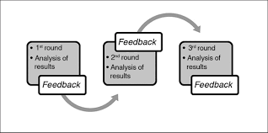
Building the evidence
How do we know our teaching is evidence based and meeting industry needs?
Building the evidence
Delphi Process (evidence)
Building expert consensus
Identifying core capabilities, competencies, knowledge, skills, topics
Evidence for curriculum focus and change

