Slide 1
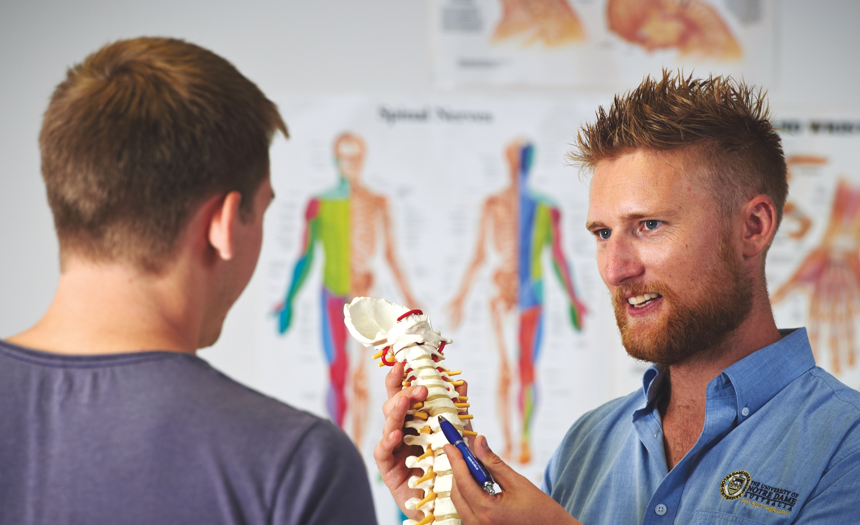
Mindfulness
Fremantle
Broome
Sydney

Slide 2
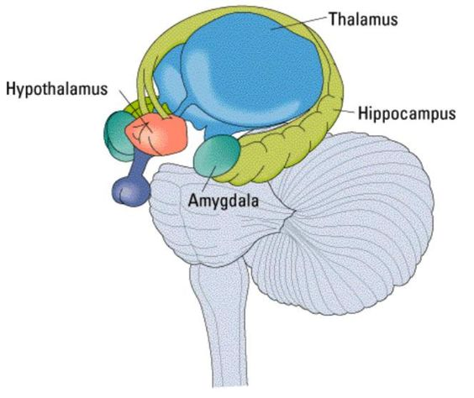
Pain & stress
Pain is a tissue damage alarm
Part of the body’s stress management system
Stress is anything that disrupts homeostasis (balance)
Stress = threat = damage (tissue)
Limbic system (homeostasis central)
Endocrine, autonomic, immune, motor
Emotional, behavioural responses
Fear (anxiety, panic) (amygdala)
Memory (hippocampus)

Slide 3
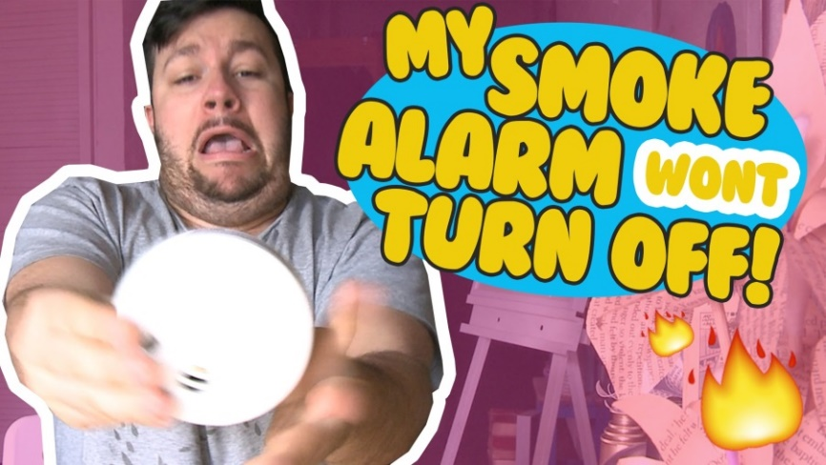
Pain and maladaptive focus
Chronic pain is perceived as a persisting threat
The tissue damage alarm keeps on ringing
Limbic system in overdrive
Intrusive, hard to switch off (smoke detector)
Stress responses, fear, anxiety
Reinforces & amplifies threat
Threat memory
Vicious cycle of ‘maladaptive attention’ & conditioning

Slide 4


Pain = fear
Pain & fear (anxiety) are the same thing
Both protect tissues from damage
Shared facial expressions & behaviours
Shared neurochemistry
-serotonin, nor-epinephrine
Shared neuroanatomy & function
Limbic system responses
Maladaptive attention

Slide 5
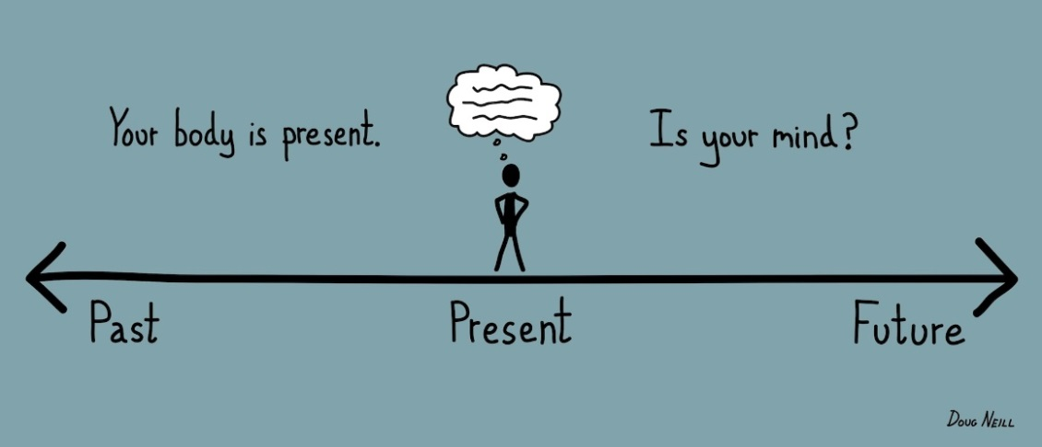
Maladaptive attention
Hypervigilance (present focus)
Rumination (past focus)
Catastrophizing (future focus)
Increased ‘range’ of attention (distracting, exhausting)
ATTENTION
Ruminating
Hypervigilance
Catastrophizing

Slide 6

Refocusing attention
ATTENTION
Ruminating
Hypervigilance
Catastrophizing

Slide 7
Mindfulness
re-focusing
attention Mindfulness-Based Stress
Living in the moment
Re-focuses maladaptive attention
Away from the ‘threat’
Interrupts reinforcement & conditioning
Reduces stress
More than ‘distraction’
Active coping strategy
.

Slide 8
Mindfulness techniques
Mantra (focus)
Breathing
Body scan
Mindful walking, eating, listening
Thought-blocking (bat it away)
Going with the flow (the river)
Yoga/Tai Chi/Pilates

Slide 9
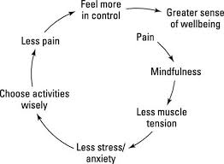
Mindfulness
in pain clinics
Effective part of multidisciplinary pain management
Simple, cheap, active self-management
Integrates well with movement techniques
Yoga & Tai Chi
Educates us about body-mind & (w)holism
Easier patient engagement than CBT
Still takes a lot of effort, ‘practice’
Evidence-base (more research is needed!)

Slide 10
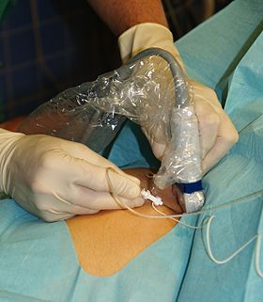

From blocks to Buddhism

Slide 11
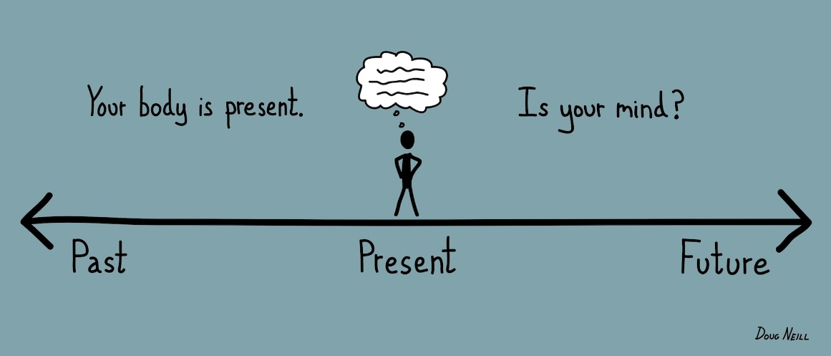
Mindfulness
re-focuses
maladaptive attention Mindfulness-Based Stress
ATTENTION
Ruminating
Hypervigilance
Catastrophizing

Slide 12


Slide 13
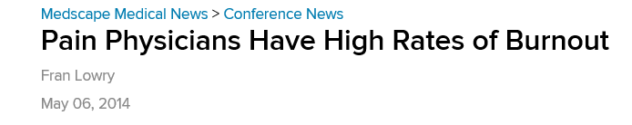
Pain staff stress & burnout

Slide 14
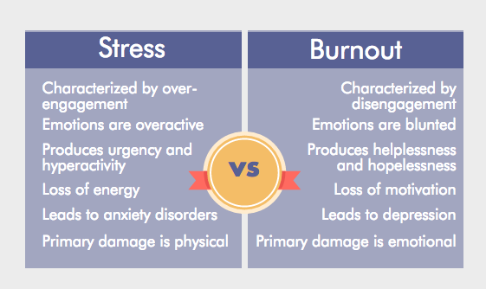
Stress & burnout
Fight
Fade

Slide 15
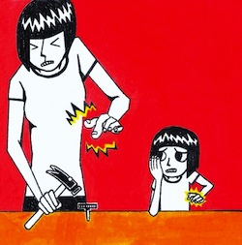
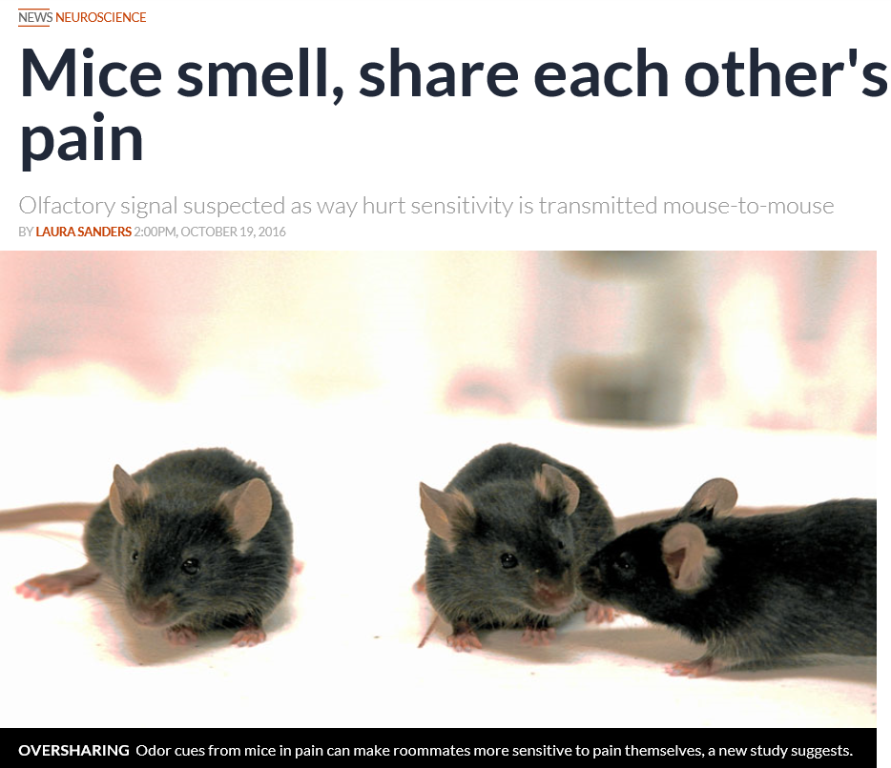
Pain transference

Slide 16
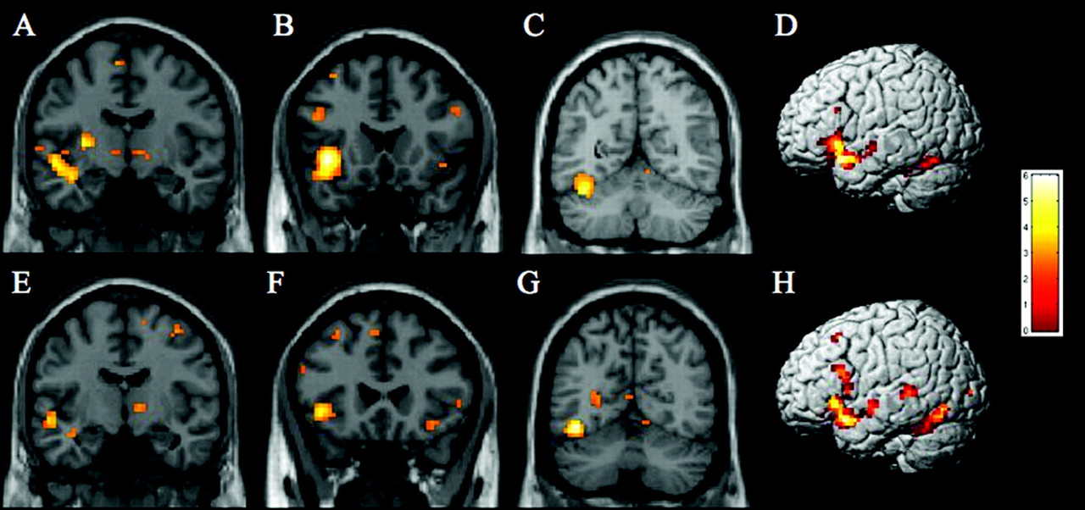
Limbic system
again!

Slide 17

Limbic changes on MRI

