Slide 1
Low Back Pain in General Practice
Assoc Prof Lucy Gilkes
Professor Eric Visser

Slide 2
Learning outcomes
Low back pain (LBP) as a major healthcare problem
Classification of low back pain: applied anatomy
Diagnostic approach to LBP: how to take a back pain history
Role of investigations in LBP
RED flags: early recognition of serious causes of LBP
YELLOW Flags: psychosocial stressors → chronic pain & disability
Multidisciplinary pain management
Analgesics & LBP: the opioid dilemma

Slide 3
Definitions
Pain: An unpleasant sensory & emotional experience associated with actual or potential tissue damage
Chronic pain ≥ 3M (beyond the time of normal tissue healing)
Low back pain: pain experience in the lower back region, posterior costal margins to gluteal folds of buttocks
Spinal pain: thoracic spine (‘back pain’), neck pain

Slide 4
Classifying LBP
Timing?
Acute or chronic LBP? (≥3M)
Can you identify a specific ‘’pain generator’’?
Specific LBP? (e.g. vertebral fracture, facet joint OA) (20%)
Non-specific LBP? (80%)
Leg pain present? (20%)
Referred leg pain? (from musculoskeletal structures) (2/3rd)
Radicular pain? (from spinal nerve root) (‘sciatica’) (1/3rd)

Slide 5
Most common classification of LBP
Acute or chronic,
non-specific,
low back pain,
with (or without) leg pain

Slide 6
Spinal jargon
Spondylosis: ‘degenerative’, OA changes in the spine (e.g. facet joints, discs)
Spondylitis: inflammation of the spine (e.g. seronegative arthropathy, AS)
Spondylolisthesis: ‘slippage’ of one vertebral body on another
Radiculopathy: nerve root related pain or symptoms (limbs)
Sciatica: not a technically correct term

Slide 7
Chronic LBP is common & consequential
10% of the population
2.2 million Australians right now
10% of GP visits
50% of pain clinic visits (wait >150 days)
Top 10 health care burdens worldwide
The leading cause of disability worldwide (mental health, depression, anxiety)
Chronic pain costs $A73.2 billion/year including lost productivity

Slide 8
Causes of LBP
Acute low back pain (transititions to CLBP in 20% of cases)
Injury (work, sports) (lifting, twisting, straining, repetitive loading)
Surgery (‘failed back surgery syndrome’)
Spondylosis (‘spinal’ ‘degeneration’) (discs, facets)
Pathology (red flags)
Pregnancy
Physical deconditioning ($↑$ BMI, poor fitness, lack of exercise)
Smoking
Genetics (disc pain, connective tissue/hypermobility)
Parreira P, Maher CG, Latimer J, Steffens D, Blyth F, Li Q, Ferreira ML. Can patients identify what triggers their back pain? Secondary analysis of a case-crossover study. Pain 2015 Jun 1. PMID: 26039901

Slide 9
Spinal anatomy 101

Slide 10
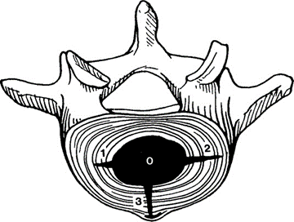
Specific causes of LBP The search for pain generators
Intervertebral discs (40%)
Internal disc disruption
Annular tears
Younger LBP patients (30s-50s)

Slide 11
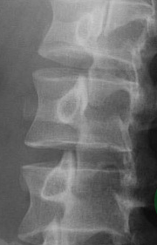
Specific causes of LBP The search for pain generators
Facet joints (20%)
Older LBP patients (>65)
L4/5 & L5/S1

Slide 12
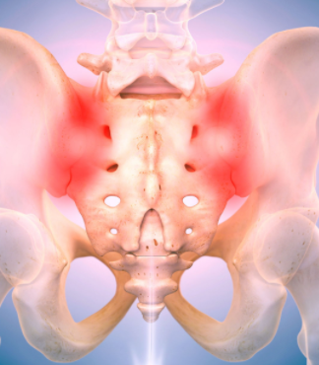
Specific causes of LBP The search for pain generators
Sacroiliac joints (20%)
Biggest joint in body
Syndesmosis
Sacroiliitis (spondyliitis)
Seronegative arthropathy

Slide 13
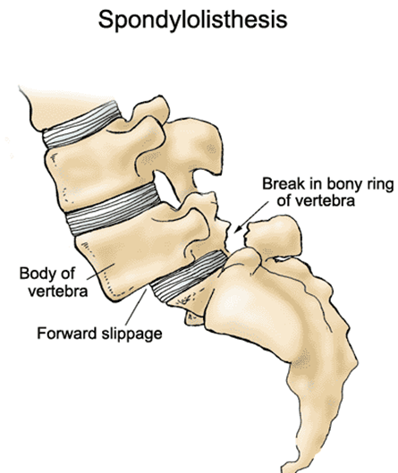
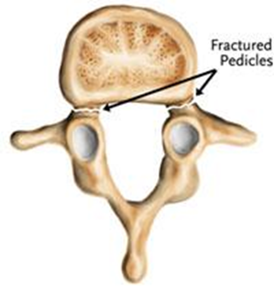
Specific causes of LBP The search for pain generators
Pars defects
Congenital
Fast bowlers

Slide 14
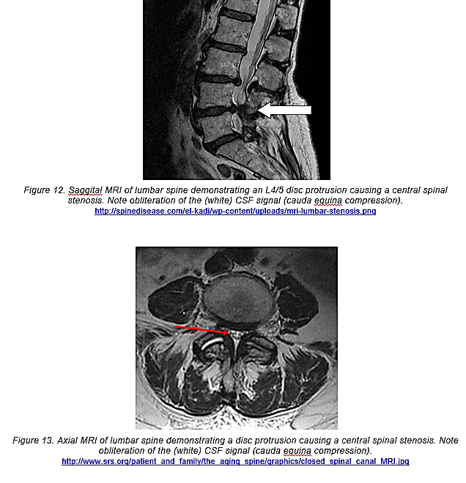
Spinal stenosis
Older patients with…
Low back pain
Bilateral leg pains
Claudication (neurogenic)
‘Tight canal’ on imaging
Supermarket trolley test

Slide 15
Not all back pain comes from the spine
Myofascial structures (thoracolumbar fascia)
Gluteal muscles (buttock pain)
Vascular (AAA) (red flag)
Renal (renal calculi, pyelonephritis)
Pelvic/gynaecological (pregnancy)

Slide 16
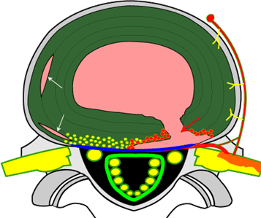
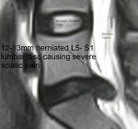
LBP with leg pain
Referred leg pain (90%)
referred from musculoskeletal structures such as discs, facet joints, muscles
Radicular leg pain (10%)
90% improve at 3/12 watchful waiting
Radiculitis or compression by a disc
L5 or S1 nerve root (90%)
Neurological features: foot/ankle numbness, weakness, reflexes
Straight leg raise test + (nerve root irritation)
If considering intervention due to red flag symptoms then do imaging (MRI) to confirm diagnosis and plan treatment

Slide 17
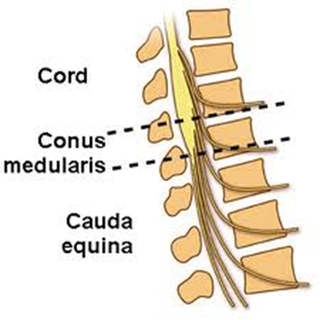
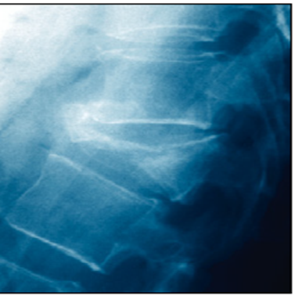
Red flags T.I.N.T
Tumour
Infection (discitis, IVDU)
Inflammation (spondylitis)
Neurological
-cauda equina: numb bum: saddle & legs
weak bladder, bowel & legs
-radiculopathy
Trauma (vertebral fracture)

Slide 18
Red flags T.I.N.T
Vascular
Pelvic/pregnancy
Renal

Slide 19
GP’s need to know how to diagnose and manage back pain.
Murtagh’s Diagnostic Model
Probability diagnosis
Serious disorders not to be missed
RED FLAGS “TINT”: Tumour, Infection/Inflammation, Neurological, Trauma
Pitfalls in diagnosis
Masquerading conditions
Is the patient trying to tell me something else?

Slide 20
4 patients present to their GP
A young man presents with low back pain (LBP).
An 80 year old woman presents with LBP.
An 80 year old man presents with back pain.
A 45 year old mechanic presents with acute LBP which also goes down his right leg

Slide 21
A young man with back pain
History
Low back pain for years ,slowly worsening. The pain comes in waves; it increases in intensity for a few days (sometimes he has to miss work) and then would subside back down to a basal level of pain. Each episode has been gradually exceeding the last.
The pain is worse in the morning, it is associated with severe stiffness on first waking but after walking around for an hour or so the pain eases a little, the back improves a bit but remains fairly stiff. At its worst the pain is 6/10 at its best it is 3/10. It is making it difficult for him to work he is an electrician. He has to climb into small spaces this is really difficult.
The pain does not radiate anywhere else
No history of injury.
Responds partially to anti-inflammatory tablets. Not to paracetamol.
Examination
Significantly reduced lumbar spine flexion (Schobers test of spinal flexion increases from 15cm to 17cm only) and markedly reduced left and right lateral flexion. Sacral thrust test is positive with pain felt in both sacroiliac joints.

Slide 22
A young man with LBP
Murtagh:
Probability diagnosis?
Serious disorders not to be missed
Pitfalls in diagnosis
Masquerading conditions –
Is the patient trying to tell me something else?

Slide 23
A young man with LBP (this is unusual)
Murtagh:
Probability diagnosis?
Serious disorders not to be missed RED FLAGS: T.I.N.T (Inflammation?)
Pitfalls in diagnosis – Ankylosing Spondylitis - Average diagnostic delay was 6.05 +/- 5.08 years*
Inflammatory back pain should be emphasized as the main screening criterion for primary care physicians.*
Masquerading conditions –
Is the patient trying to tell me something else?
Dincer U, Cakar E, Kiralp MZ, Dursun H. Diagnosis delay in patients with ankylosing spondylitis: possible reasons and proposals for new diagnostic criteria. Clin Rheumatol. 2008;27(4):457-462. doi:10.1007/s10067-007-0727-6

Slide 24
Inflammatory vs non-inflammatory joint pain
Feature | Inflammatory | Noninflammatory
Systemic symptoms | Prominent, including fatigue | Unusual
Onset | Insidious in rheumatoid arthritis Sudden in gout or infection | Gradual 1 joint or a few joints
Morning stiffness | > 1 hour | < 30 minutes
Worst time of day | Morning | As day progresses
Effect of activity on symptoms (joint pain and stiffness) NSAIDs | Lessen with activity Worse after periods of rest May also have pain with use Often benefits | Worsen with activity Lessen with rest Sometimes benefits ( or no benefit)

Slide 25
An 80 year old woman with Back Pain
Recently developed troublesome back pain which has been worsening over the last month (Never really suffered from this much before)
Describes it “In the middle of my back, just below my bra strap”
Pain is worse at night and prevents sleep
A dull boring pain (8/10) which is helped a little bit by Panadol and also nurofen.
She has been feeling generally unwell and thinks she might have lost weight recently - her clothes are feeling a bit looser.
No pain in buttocks or legs. No sensory changes. No change in bladder or bowels.
Examination: Appears in distress due to pain, afebrile, restriction of thoracic movement in all directions and localized tenderness T12

Slide 26
An 80 year old woman with Back Pain
Murtagh: Probability diagnosis
Serious disorders not to be missed
Pitfalls in diagnosis
Masquerading conditions
Is the patient trying to tell me something else?

Slide 27
An 80 year old woman with Back Pain
Murtagh: Probability diagnosis
Serious disorders not to be missed RED FLAGS: T.I.N.T (Trauma, Tumor?)
-osteoporotic vertebral fracture, Metastasis?
Pitfalls in diagnosis
Masquerading conditions
Is the patient trying to tell me something else?

Slide 28
RED FLAGS (T.I.N.T)
History
Extremes of age 25< LBP >60
Cancer (Tumour)
Steroids (osteoporosis)
Fall (Trauma)
Immunocompromised (Infection)
Discitis (‘’labour pain of back pain’’)
https://www.afp-digital.org/afp/december_1_2019/MobilePagedArticle.action?articleId=1542835#articleId1542835

Slide 29
80 year male farmer with 20 years of LBP
LBP for 20 years, Hx of osteoarthritis (hands, knees).
Pain is worse at the end of the day, limited stiffness worse at the end of the day. Not responding to NSAIDS, paracetamol limited benefit. He sleeps well.
No red flags features, limited impact on function,
Daughter requests an MRI as he is getting grumpy due to the pain.
He wonders if he can have something stronger for the pain.

Slide 30
80 year male farmer with LBP
Murtagh probability diagnosis:
Serious disorders not to be missed
Masquerading conditions
Is the patient trying to tell me something else?

Slide 31
80 year male farmer with chronic LBP
Murtagh probability diagnosis: spondylosis (osteoarthrosis) (facet joints)
Serious disorders not to be missed T.I.N.T: consider prostate cancer
Masquerading conditions
Is the patient trying to tell me something else?

Slide 32
45 year old mechanic with acute LBP & leg pain
This came on suddenly when moving an engine at work.
Past history of minor back pain. He feels this normal for his occupation . He has never had an injury like this before and he has never had a work related back injury.
No weakness or tingling in the leg. No change in his bladder or bowels.No other joint pain.
He has been taking panadeine. He feels like he needs something stronger for the pain and is worried he may have a slipped disc. A work mate had this last year and was off work for ages, the bosses didn’t deal with this well and the work mate was eventually sacked. So he is very worried about this. He wants to have an MRI.
NO past history
Examination findings: Walks with difficulty and appears uncomfortable when sitting down
Significant limitation of all lumbar movements with some paraspinal muscle spasm L 3-5.
Normal power, tone, reflexes and coordination in lower limbs.
Slump test exacerbates the pain down the leg.

Slide 33
45 year old mechanic with acute LBP & leg pain
Murtagh
Probability diagnosis:
Serious disorders not to be missed
Pitfalls in diagnosis
Masquerading conditions
Is the patient trying to tell me something else?

Slide 34
45 year old mechanic with acute LBP & leg pain
Murtagh probability diagnosis: acute low back pain with leg pain
Leg pain: either referred somatic leg pain > radicular leg pain
Serious disorders not to be missed T.I.N.T (Neurological?)
-Cauda equina or severe radiculopathy?
KEY MESSAGE: Are there any neurological losses?
-weakness (legs, bladder, bowel), numbness (legs, saddle), ↓ reflexes.
LOSS of FUNCTION = neurosurgical EMERGENCY
Pitfalls in diagnosis,
Masquerading conditions
Is the patient trying to tell me something else?

Slide 35
The mechanic comes back 6 months later
His pain has persisted and seems to be getting worse
As he feared his workplace are not being supportive. He is being forced to see a lot of rehab providers and ‘company doctors’ but he feels they are ‘not on his side’. Workers comp has stopped paying for his massage sessions. He feels they were the only treatment which was helping.
He cannot work. He is doing less and less around the house, he is scared to do any physical activity as he is concerned it will make the pain worse. His wife is doing all the home maintenance, shopping etc that he used to do. She is trying to be supportive but the relationship is under strain.
He has been taking increasing amounts of tramadol to try to control the pain. He has gained 5kg in weight and started drinking in the evenings.
He had an MRI and was alarmed by all the ‘degeneration’ it showed.
He can’t see any light at the end of the tunnel as everything seems to keep getting worse and no one can help him. He feels like he will have this pain forever and he has no control over anything in his life.
His GP wants him to see a psychologist which is making him angry as he feels the GP doesn’t believe he is in pain.

Slide 36
The mechanic comes back 6 months later
45 year old mechanic has now developed chronic LBP & leg pain
Acute-to-chronic pain transition (20% of cases)
Yellow flags are strongest predictors of developing CLBP & disability
Workers’ compensation, conflict, anxiety (PTSD), depression, smoker
Need for a comprehensive multidisciplinary approach to assessment and management.

Slide 37
Yellow flags (CHAMPS) Predicts chronic pain & disability
Catastrophizing (ruminating, injustice)
Hyper-vigilant
Anxious (panic & PTSD)
Medicalized
Passive coping (‘fix me’, compensation)
Substance overuse
- Chemical coping, alcohol, smoking, THC, opioids, OTC analgesics, sedatives
Stress (sick of work)
SZ George, JM Beneciuk MC Musculoskeletal Disorders 2015

Slide 38
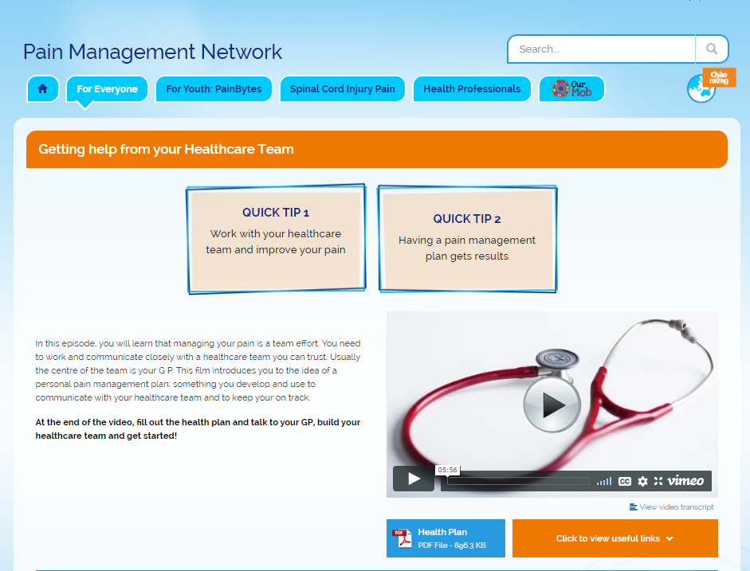
Managing Chronic Low Back Pain in GP
Principles:
Education +++
Multidisciplinary team ++
Be careful with
Imaging
Prescribing
https://www.youtube.com/watch?v=C_3phB93rvI
https://www.aci.health.nsw.gov.au/chronic-pain/for-everyone/getting-help-from-your-healthcare-team
Know when to refer

