Slide 1

Abdominal & Visceral pain
Medi6100
Fremantle
Broome
Sydney

Slide 2
Student Learning Outcomes
Describe the basic pathophysiological mechanisms underlying conditions causing acute lower abdominal pain, giving an example of a clinical condition from each category.
-Labour pain
-Dysmenorrhoea
-Appendicitis
-Irritable bowel syndrome
-Renal colic
Apply the physiology of visceral pain to other organ systems e.g. ischaemic chest pain.

Slide 3
Key issues
Visceral pain
Major health care problem & disease burden
Under-recognised compared with musculoskeletal pain
GIT diseases (appendicitis, IBS, inflammatory bowel disease, GORD)
Dysmenorrhoea
Labour pain
Pelvic pain syndromes
Renal colic
Ischaemic chest pain

Slide 4
Pain
101
Noxious = tissue damaging
Nociception: processing of noxious stimuli in the nervous system
(brain input)
Pain: an unpleasant sensory & emotional experience associated with perceived tissue damage (nociception) (brain output)
Nociceptors: receptors that convert noxious stimuli into neuro-electric signals in the nervous system
    Mechanical (stretch)
    Chemical (soup from inside damaged cell) (H⁺) (inflammation, toxins)
    Thermal
  Nociceptive neurons
        C fibres: “Dull old pain”; slow, dull, vague, burning, aching, lingering
        Aδ fibres: “Sharp young pain”; fast, sharp, well localized

Slide 5
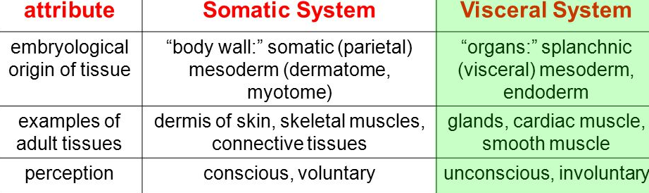

Etymology
Viscera (L. viscus): internal organs of the body
Soma (Gk. somatikos): pertaining to the body

Slide 6


Visceral sensation versus
Visceral pain

Slide 7
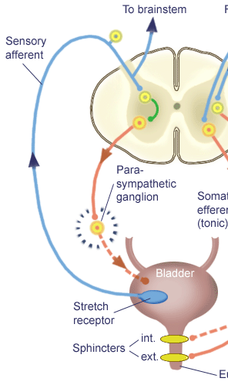
Functions of visceral sensation (Interoception)
Organ homeostasis, feedback & control
Monitoring internal bodily environment
Bladder, bowel, gut
Gut-brain axis & microbiome
Interoceptors (stretch, chemical)
  Subconscious
  Autonomic (automatic)
  Reflexive (e.g. micturition)

Slide 8
Conscious awareness of visceral sensation:
Interoception
We develop conscious awareness of visceral sensations when…
Important bodily functions need attention (voiding, defecation, satiety)
There’s potential for organ damage
Overstimulation of interoceptors → nociceptors
Sensations become unpleasant (alarm function)
Visceral pain develops…
Definition: “Pain arising from the internal organs of the body” (IASP 2012)

Slide 9
Visceral nociceptors
(interoceptors)
75% of nociceptors in body are found in somatic structures
Only 15% of nociceptors are in visceral organs
Suggests pain is NOT primary function of visceral nociceptors
Visceral nociceptors = interoceptors
    High threshold (lots of stimulation needed)
    Polymodal (responds to variety of stimuli)
    Slow onset, slow offset

Slide 10
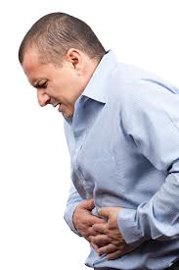
Visceral
nociceptors found in
‘Smooth muscle ‘tubes’ (stretch)
  gastrointestinal
  genitourinary
  vasculature (heart)
Covering membranes (peritoneum, pleura, pericardium)
Parenchyma-solid organs (liver, pancreas, thyroid)
Not much “interoception/nociception’’ from solid organs
May have minimal pain with liver metastases

Slide 11
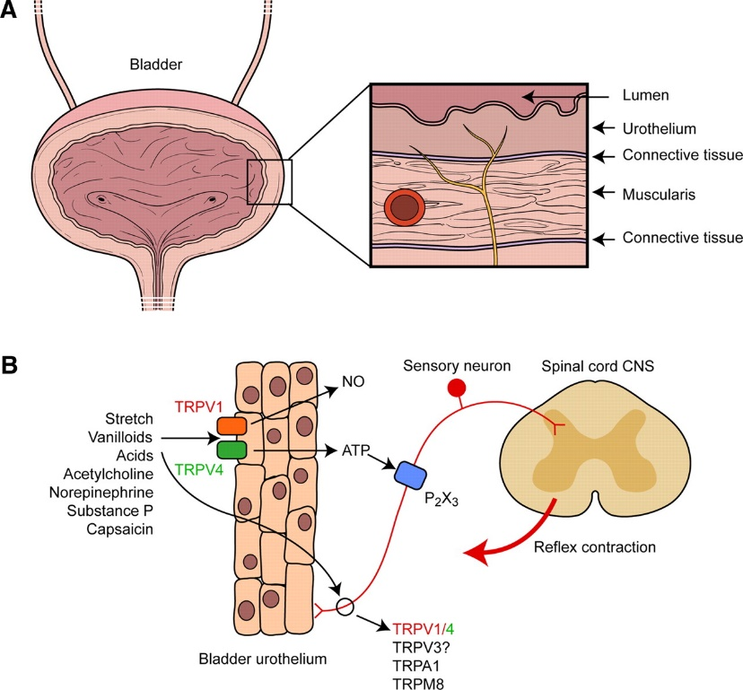
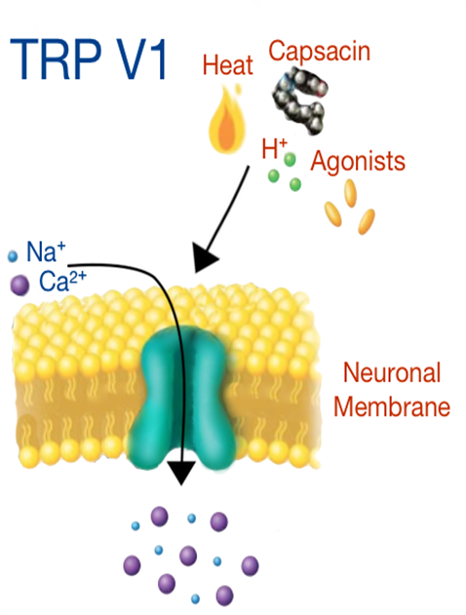
Visceral
nociceptors
Mechanoreceptors (‘stretch & strain’)
-full bladder, bowel
Chemoreceptors
-Protects body from ingested toxins e.g. plants
-TRPV ion channels (H⁺, capsaicin, chilli, menthol)
-Triggers
-Chemical (plant alkaloids e.g. opioids)
-Inflammation (inflammatory bowel disease)
-Neuro-immune
-Ischemia (myocardial infarction)

Slide 12
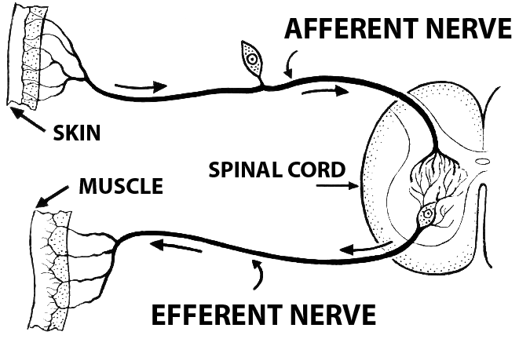
Afferent & efferent
nerve pathways
Afferents Arrive
Afferents carry CNS inputs
Efferents Exit
Efferents carry CNS outputs

Slide 13
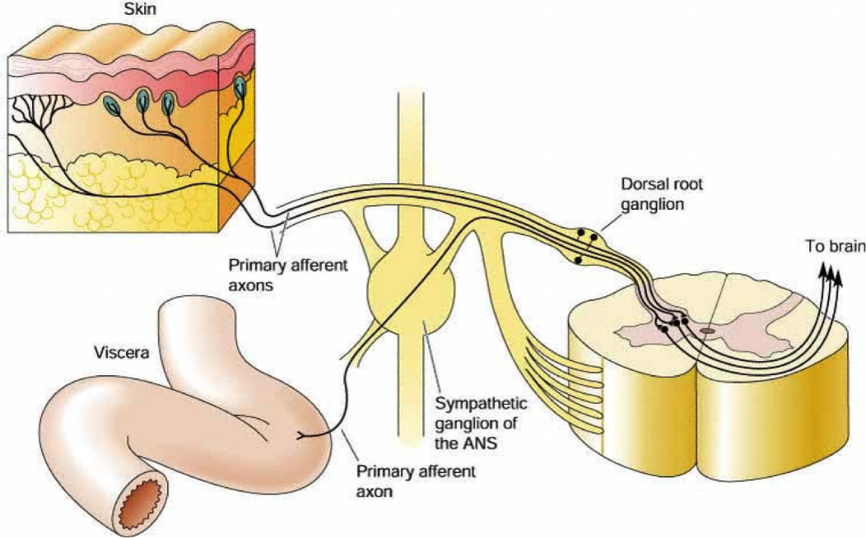
Visceral afferents
neurons
  Mainly C fibres: “Dull old pain”
  Aδ fibres: “Sharp young pain” (peritoneum)
Visceral afferents (mainly C-fibres) run along-side sympathetic nerves
Don’t get confused: visceral nociception (pain) is NOT actually transmitted by sympathetic nerves
Embryology: organs need autonomic & sensory innervation, so both types of nerves run together

Slide 14
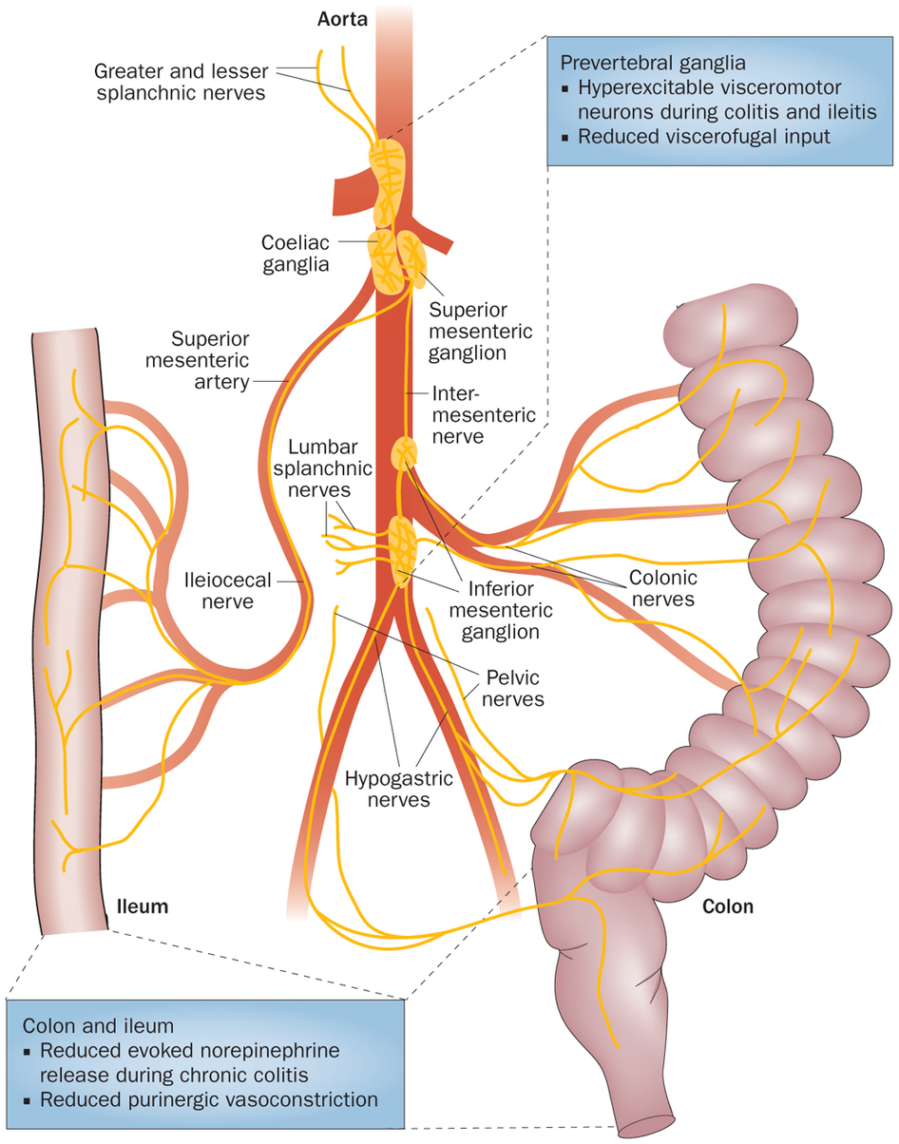
Visceral
afferents run with sympathetic nerves

Slide 15
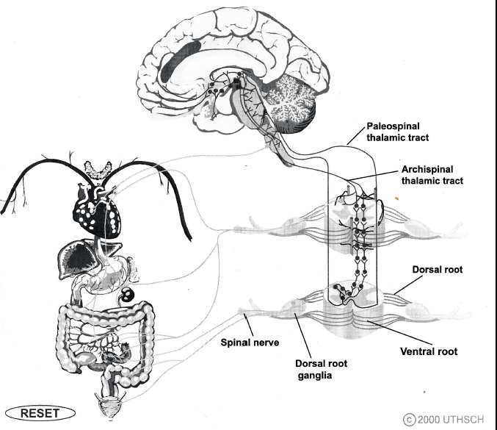
Transmission of visceral sensation
Limbic system
Visceral
spinal cord pathways
Dorsal horn
Viscera
Visceral afferents

Slide 16
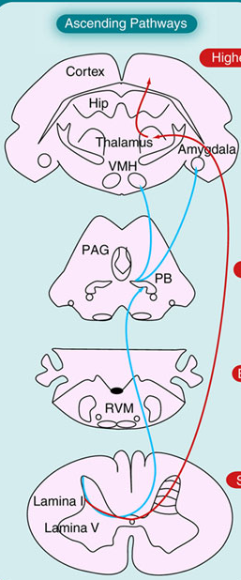
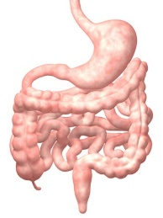
Spinal cord sensory pathways
© Future Neurol 2007
Thalamo-cortical system
Limbic system
Primitive emotional brain
IN-BOARD pain pathways
OUT-BOARD pain pathways
Spino-parabrachial-limbic pathway
Earliest evolutionary pathway
Primitive
SLOW, POORLY LOCALISED TRANSMISSION
Spino-thalamic pathway
Later evolutionary pathway
FAST, WELL LOCALIZED TRANSMISSION
Visceral afferent nociceptive
C-fibre

Slide 17
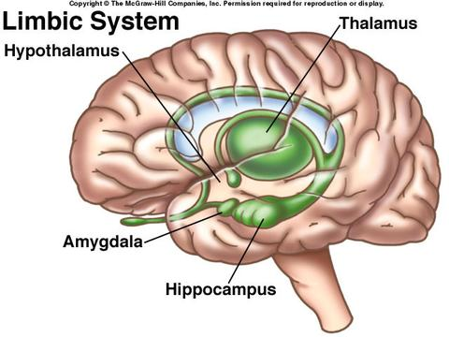
Visceral pathways end in limbic brain
Pain ‘relay station’
Visceral spinal pathways
end in limbic system
‘Primitive’ midbrain
Explains emotional, behavioural, autonomic, motor & memory responses common in visceral pain vs somatic pain
Autonomic
Cingulate gyrus
Fear & anxiety
panic
Memory of pain
Visceral nociception &
sensory information

Slide 18


Visceral pain, panic & limbic activation
Angor animi
Most chest pain presentations have a ‘panic’ component
Acute coronary syndrome activates the limbic system (anxiety)
A panic attack can trigger chest pain (very common in the ED)
Many patients having heart attack feel sense of ‘impending doom’
Angor animi: panic attack variant
Linked to limbic system activation (anxiety, autonomic responses)
Need to treat visceral anxiety as well as pain

Slide 19
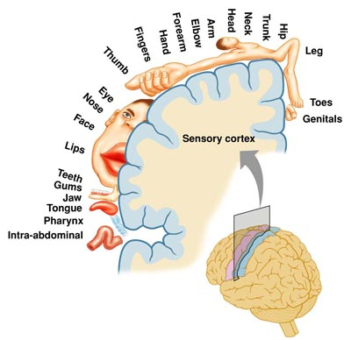
Somatosensory
cortex
Visceral organs are poorly represented in the somatosensory cortex
That’s why it’s difficult to localise visceral pain in our body
Lack of cortical representation of visceral organs helps explain referred pain
Sensory homunculus (body-map)

Slide 20
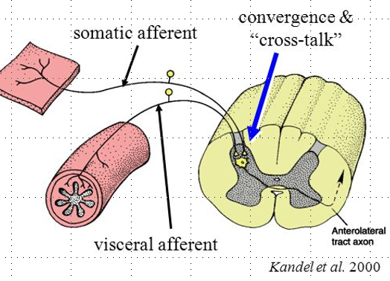
Referred
pain
Definition: Pain experienced in a different part of the body to the site of nociception
Sensory afferents from visceral
& somatic tissues share a common
connection in spinal dorsal horn
Dorsal horn convergence

Slide 21
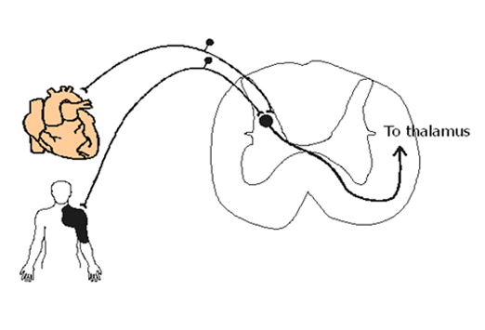
Dorsal horn convergence
T2/3
dorsal horn level
T2/3
dermatome

Slide 22
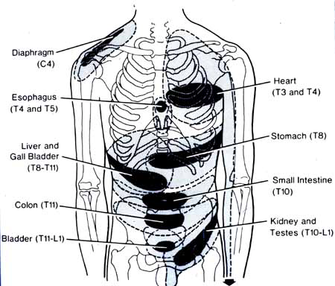
Referred pain
‘viscerotomes’
appendix
Originally from Cousins and Bridenbaugh's Neural Blockade in Clinical Anesthesia and Pain Medicine

Slide 23
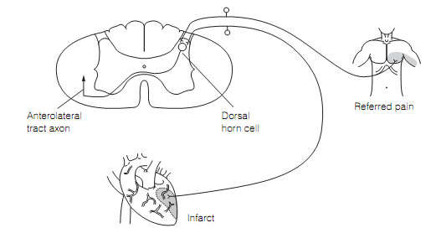
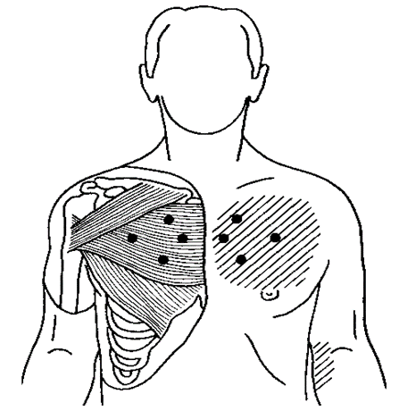
Referred
visceral-somatic
pain (allodynia)
‘’Pain’’ (nociception) in a viscus (organ) produces pain (allodynia) in somatic tissues sharing the same dorsal horn level in the spinal cord (convergence)
Cardiac ischemia (angina) produces chest wall muscle pain and sensitivity
Reverse direction of nerve activation
(‘’antidromal’’)
Muscle tenderness, trigger points
Cutaneous allodynia
Neurogenic inflammation in tissues
Tissue oedema
Sympathetic & vascular changes

Slide 24
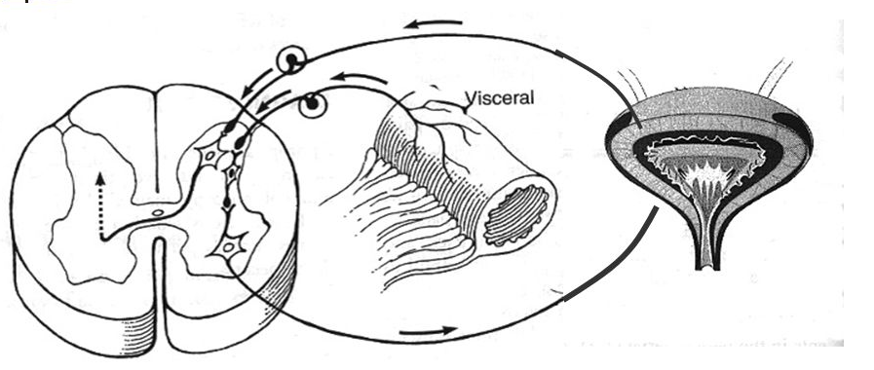
Referred
visceral-visceral pain (hyperalgesia)
’Pain’’ (nociception) in a viscus (organ) produces pain (allodynia) in another viscus sharing the same dorsal horn level (convergence)
Bowel pain (e.g. inflammatory bowel disease) triggers bladder pain, sensitivity
and smooth muscle reflexes

Slide 25
Comparing visceral &
somatic pain
(must-know)
Visceral pain | Somatic pain
Few nociceptors (15%) C-fibres | Many nociceptors (75%) A-δ fibres
Function: homeostasis > nociception | Function: nociception > homeostasis
Transmission with autonomic nerves | Transmission in somatic nerves
Terminates in superficial dorsal horn (I,II,V) | Terminates in deeper dorsal horn (II,V,X)
Medial (slow) spinal cord pathways Spino-parabrachial-limbic, dorsal columns | Lateral (fast) spinal cord pathway Spinothalamic
Terminates in limbic brain ‘Primitive’ mid-brain Limbic-hypothalamic-autonomic system | Termination in thalamus & cortex Neocortex
Pain: slow onset & offset burning, aching, gripping, colicky | Pain: fast onset & offset sharp, throbbing
Pain ≠ tissue damage | Pain ≈ tissue damage

Slide 26
Comparing visceral &
somatic pain
(must-know)
Visceral pain | Somatic pain
Pain is poorly localised (midline, torso) Localised with flat of hand | Pain is well localised (‘lateralized’) Localised with tip of finger
Referred pain | Minimal referred pain
↑ Emotion & pain behaviour (distress) (Limbic system) | ↓ Emotion & pain behaviour
Pain more likely to be remembered | Pain less likely to be remembered
↑ Autonomic response Sympathetic & parasympathetic | ↓ Autonomic response
‘Vegetative’ motor response ‘Rest & recover’ (rest & digest) | ‘Reactive’ motor response Flight, run away from danger
Evolutionary primitive pain system | Evolutionary advanced pain system
Monitors internal environment | Monitors external environment

Slide 27
Summary
key messages
Visceral pain
Visceral interoception & nociception monitors internal bodily environment
Transmitted by C fibres & midline spinal pathways (slow transmission)
Poorly-localized pain (midline, diffuse, deep, dull, aching, ‘colicky’)
Projects to limbic system (emotional & autonomic brain)
Emotional & behavioral distress (PANIC)
Autonomic responses (nausea, sweating, vasovagal, diarrhea)
Referred pain (dorsal horn convergence)
Visceral-somatic & visceral-visceral referred pain (convergence)

Slide 28
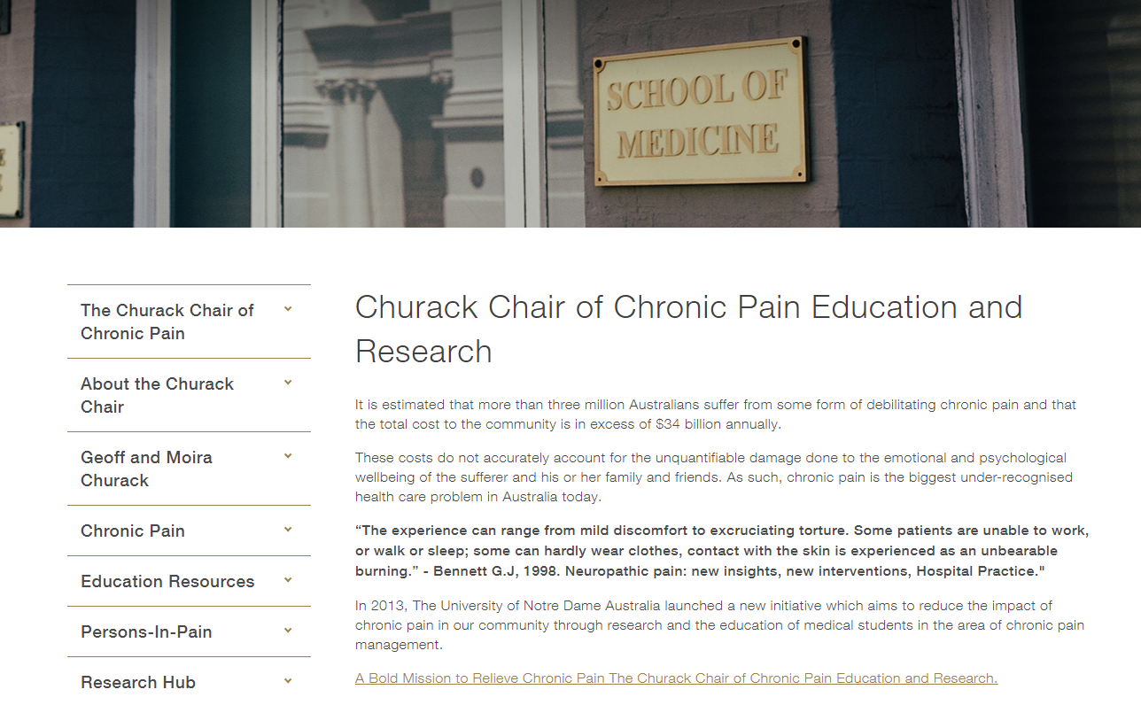

Slide 29
End of lecture additional slides follow

Slide 30
Key
learning outcomes
Visceral pain
Recall the definition of visceral pain.
List the major differences between visceral & somatic pain (see table).
Understand the difference between an afferent & efferent pathway.
Recall that visceral afferents travel with sympathetic nerves in the periphery.
Understand that visceral sensation is transmitted via ‘slow’ midline spinal cord pathways that terminate in the limbic system (midbrain).
Recall that the limbic system controls emotional & autonomic responses that
are common in patient with visceral pain.
Understand that anxiety, panic & distress are common in visceral pain.
Recall that visceral & somatic afferents converge in the spinal dorsal horn.

Slide 31
Key
learning outcomes
Visceral pain
Recall referred pain as, ‘(pain) experienced in a different part of the body to the site of nociception’.
Understand mechanism & features of referred pain & concept of dorsal horn convergence.
Understand that pain (nociception) in one organ increases pain sensitization in nearby organs or tissues due to dorsal horn convergence (referred visceral hyperalgesia).
Understand basic pathophysiology & anatomy of common visceral pain syndromes: appendicitis, irritable bowel syndrome, renal colic, labour pain, dysmenorrhoea, pancreatic cancer pain, ischaemic chest pain.
Understand basic concepts of the gut-brain axis & gut microbiome.
Understand that abdominal pain can come from structures in the abdominal wall, spine, chest, or due to medical condition such as porphyria or DKA.

Slide 32
Self-direct study
Visceral pain
Trace the basic pathways for transmission of nociception to the
brain from the:
-uterus
-descending colon
-vermiform appendix
-ureter
List the ‘viscerotomes’ for these structures
How does an epidural block reduce labour pain?
Explain why appendicitis is often ‘felt’ around the umbilicus early on
and later moves to Mc Burney’s point?

Slide 33
Self-direct study
Visceral pain
Explain why a women with irritable bowel syndrome is more likely to
suffer with severe dysmenorrhoea?
Explain why a man treated for renal colic reports exquisite
tenderness to gentle massage over the flank muscles on same side?
List the clinical pain features which distinguish a man in the ED with
renal colic, from man with acute flank pain after lifting a heavy box
at work?

Slide 34
Visceral
spinal cord pathways
Spinal-parabrachial-limbic pathway & dorsal columns
Midline of spinal cord
Transmits nociception, pressure, stretch, chemical ‘information’
‘Primitive’, slowly-responsive system
Midline spinal cord pathways: first to develop in evolution
-major sensory & nociceptive pathway in lower vertebrates & crustaceans
Lateral spinothalamic pathway evolved later, transmits ‘fast’
easy-to-localise sensory information from body’s outer surface

Slide 35
Examples
Visceral-somatic pain (allodynia)
-loin muscle tenderness & trigger points in renal colic
-chest wall tenderness & swelling in angina
-epigastric muscle tenderness in peptic ulcer pain
Visceral-visceral pain (hyperalgesia)
-peptic ulcer pain & biliary colic
-irritable bowel & irritable bladder
-irritable bowel & dysmenorrhoea
-reflux oesophagitis & angina

Slide 36

Gut
feelings
“Gut feeling”
‘’Trust your gut’’
“Butterflies”
Gut brain axis
90% body’s serotonin
Microbiome
Interface with external world
Neuroimmune
Gut interoception & nociception are important

Slide 37
Gut
feelings
Interoception: monitoring internal bodily environment
Gut is a major interface with external environment
Food, toxins, pathogens, immune system
Is this basis of our ‘gut feelings’?
Gut feelings warn us that ‘something is wrong’
Angor animi is a gut feeling that ‘I’m going to die’

Slide 38
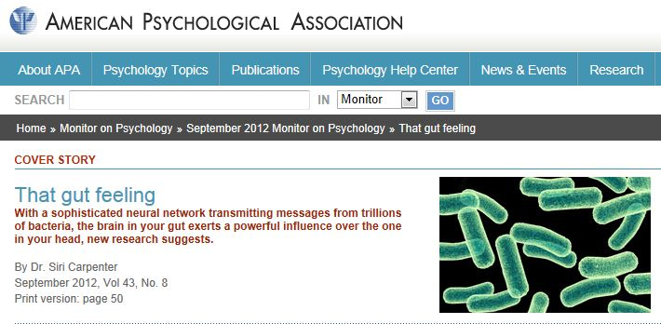
Gut-brain
axis
& microbiome
Gut
Neuro-immune
Brain
Neuro-endocrine
Gut sometimes called the ‘second brain’
Complex neural web in gut
Gut & brain share neurotransmitters
Gut’s microbiome produces 95% of body’s serotonin
Influences brain function (mood)?
“Crohn’s personality?”

