Slide 1
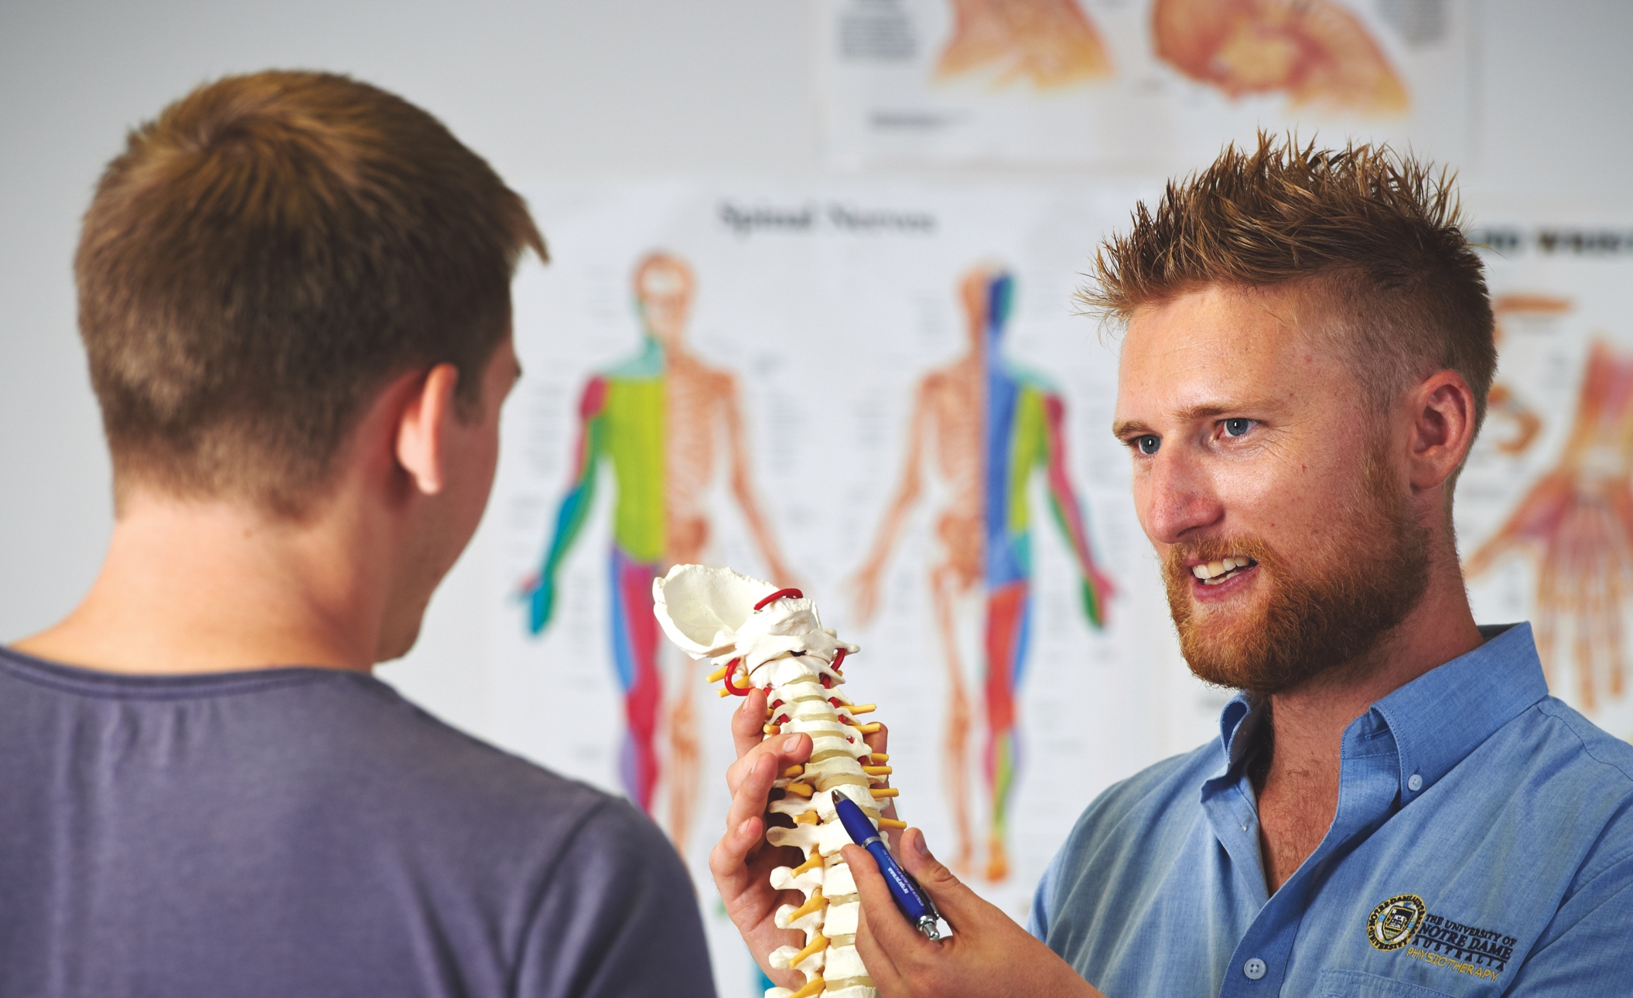
Chronic Headaches
Fremantle
Broome
Sydney

Slide 2
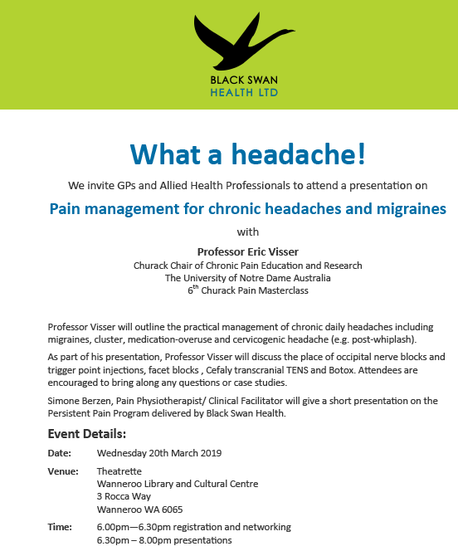

Slide 3
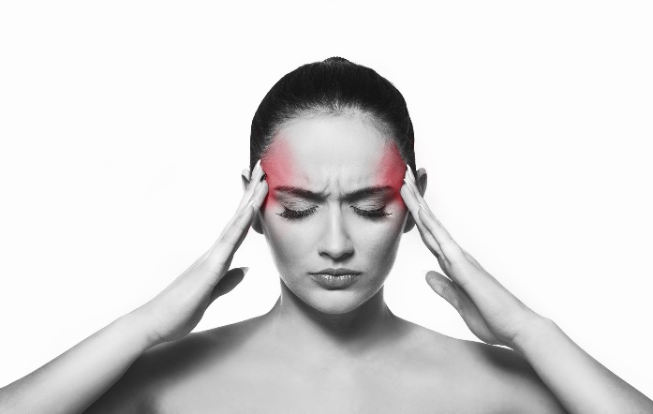

Introduction
Chronic daily headaches
≥15 headache days per month for ≥ 3 months (IHS 2013)
5% of population (F>M 4:1)
5Fs (Fearful, Female, Forties, Fat)
Caucasian, lower SES
Stress & anxiety
Quality of life & economic burden
Top-ten worldwide health disabilities (WHO)

Slide 4
Introduction
Chronic daily headaches
All chronic pain starts as acute pain
Precursor Headache
Medication Overuse
Stress
Sensitization
Chronic Daily Headache

Slide 5
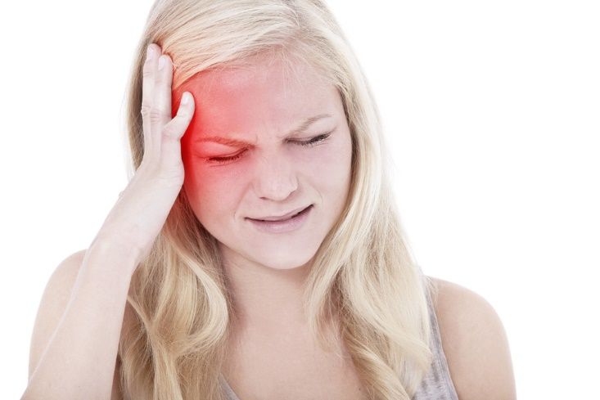
Precursor
headaches
Primary headaches
-migraine
-tension-type
-cluster
Secondary headaches
-medication overuse
-cervicogenic (‘whiplash’)
-others
-sinus, orofacial
-neuralgias (occipital, trigeminal)
-red flags

Slide 6
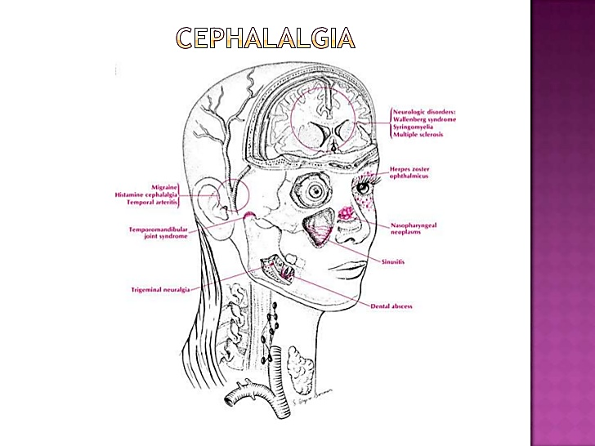
Pain generators
Head
-meninges
-skull & scalp
-nerves
-trigeminal (V)
-C²⁻³ (GON/LON)
Orofacial
-sinuses
-TMJ, ear
-teeth, nerves
Neck & shoulders

Slide 7
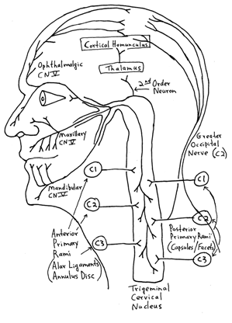
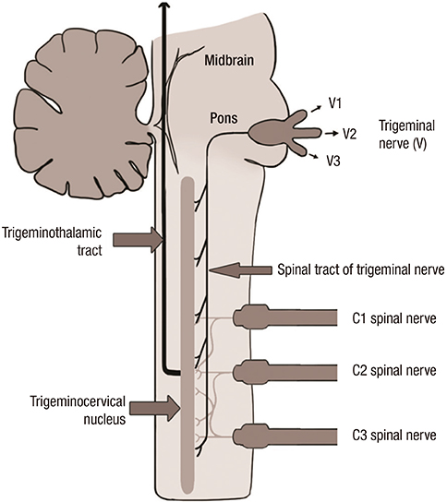
The sweet
spot
Trigeminocervical nucleus (V-C²⁻³)

Slide 8

Neuromodulation
Trigeminocervical nucleus (V-C²⁻³)

Slide 9
Chronic daily
headaches
Transformed precursor headache
Becomes more like TTH
Mild sensory sensitivity, nausea
Headache spectrum
Sensitization (V-C²⁻³)
Time patterns (morning or late day)
Cognitive & functional impacts

Slide 10
Chronic daily
headaches
Most common
Chronic migraine (transformed)
Chronic tension-type
Cervicogenic
-whiplash-associated
Medication overuse headache
New daily persistent headache (remembers exact day of onset)
Others (e.g. intracranial pressure syndromes)

Slide 11
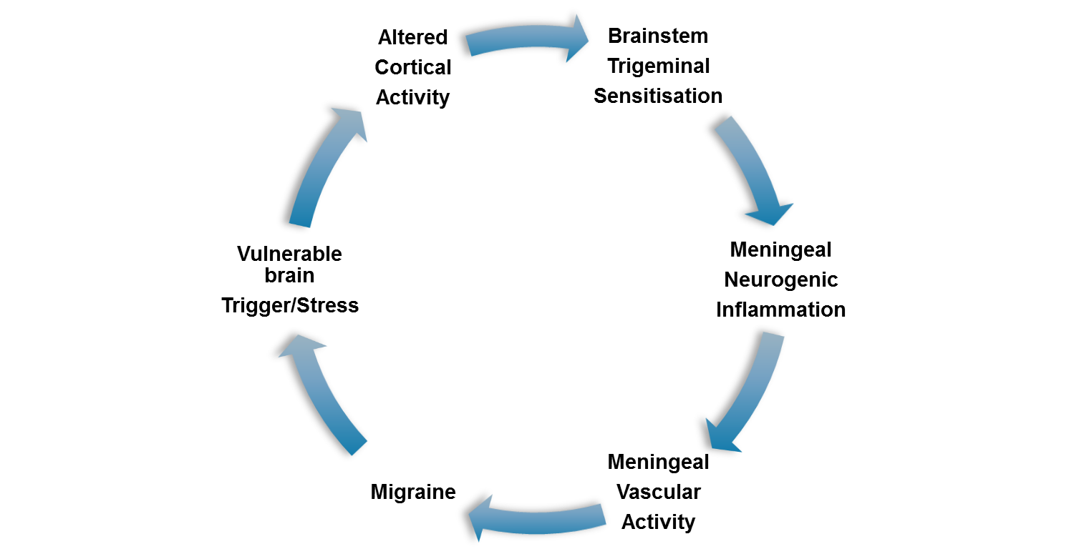
Chronic
Migraine
Neurovascular inflammatory brain disorder
Vigilant
-evolutionary advantage?
Vulnerable brain
-epilepsy-like
-visual cortex sensitivity
Channels (Na, Ca)
Mitochondria (energy)
Free radicals (NO)
Serotonin
Peptides (SP, CGRP)
V-C²⁻³

Slide 12
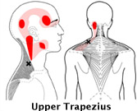
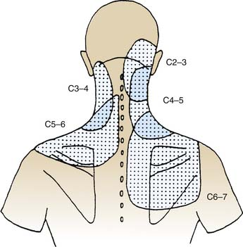
Cervicogenic
headache
Neck pain-related headache
Referred pain neck → head
Main structures in neck causing headache
-C2/3 facet joints
-occipital nerves (GON, LON, 3rd)
-trigger points (trapezius)
Whiplash-associated

Slide 13
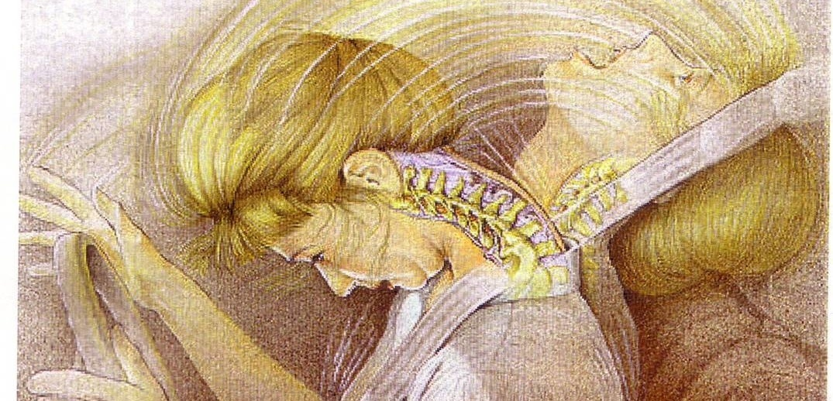
Whiplash-associated headache
Pain generators
Regional pain sensitization
-inflammation (cytokines, Toll)
-autonomic dysfunction (α receptors)
-vascular trash theory
Dural tear → CSF leak (low pressure headache)

Slide 14
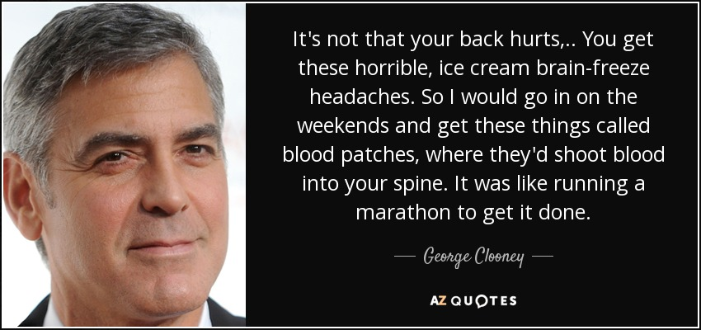
Dural tear headache

Slide 15
Medication
overuse
headache
≥10 days per month ≥3M
2% population (F>M)
Any drug affecting brain chemistry
Medications
-triptans, ergots
-opioids (codeine, pethidine)
-benzodiazepines, antihistamines
-paracetamol, NSAIDs
-caffeine, GTN
Over-the-counter analgesics
Precursor Headache
Medication Overuse
Chronic Daily Headache

Slide 16
Medication
overuse
headache
Rebound theory
Habitual behaviours
-dose control
-doctor shopping, dependency
-eye opener doses
-injections
High risk medications
-triptans
-OTC
-pethidine
Precursor Headache
Medication Overuse
Chronic Daily Headache

Slide 17
CDH
management
Bio-medical-psycho-social-environmental approach
Multimodal, multidisciplinary
Diagnosis (medication use, red flags)
Education, information & lifestyle
Pharmacotherapies
Physical therapies
Behavioural therapies
Interventions

Slide 18
CDH
management
Establish a headache diagnosis
-chronic daily headache
-precursor headache
-medication overuse
Exclude ‘red flags’ T.I.N.T (<1%)
MRI head (neck) in previous 2 years
Review by a neurologist

Slide 19
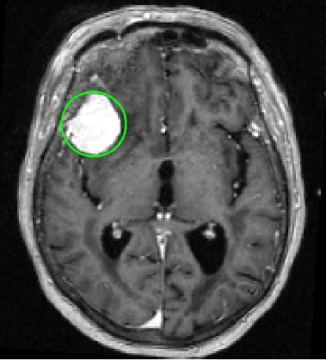
Red flags
T.I.N.T
Tumour
Temporal arteritis
Intracranial pressure
Infection
Neurovascular
Trigeminal
Trauma

Slide 20
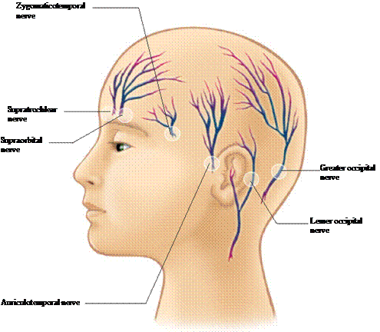
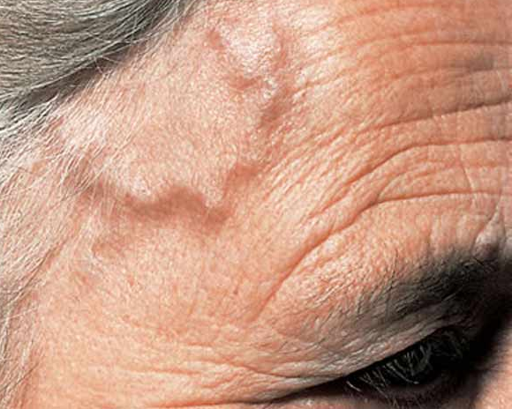
Examination
Nerves
-cranial nerves examination
-trigeminal
-scalp nerves (sensation)
-GON, LON
-temporal, periorbital
Arteries
-temporal (ESR, CRP)
-carotid

Slide 21
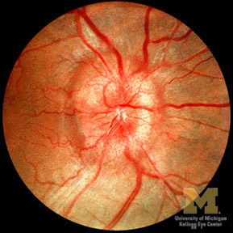
Examination
Neck & shoulders
-cervical spine
-trigger points
Orofacial
-sinuses
-TMJ, ear
-mouth, teeth
-eyes (glaucoma)
Blood pressure
Fundoscopy (papilloedema)

Slide 22
Education
Information
Medication overuse
Headache diary (triggers, medications)
Stress
Sleep
Lifestyle (work)
BMI, exercise, diet, caffeine, alcohol, smoking
Websites

Slide 23
Pharmacology
(prevention)
Topiramate
Valproate
Amitriptyline (all CDH)
Pizotifen
Erenumab
B2
Q10
Mg
Vit E
HRT
Botox
CGRPR blockers
Erenumab (monoclonal Ab)
(migraine)
ROS scavengers
NEC (trial)
Pizotifen
β-blockers
Sartans
Ca blockers (cluster)
Indomethacin (cluster)

Slide 24
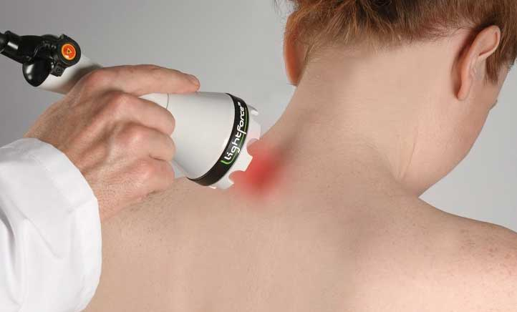
Physical therapies
Exercise
Posture
Range of movement
Manipulation (flare-up pain)
Watson technique
Trigger points
Dry needling
Low level laser (Cochrane)
TENS

Slide 25

Behavioural
Clinical psychology
Mood, anxiety
Stress reduction
Mindfulness
Yoga
Sleep
Biofeedback
Habitual behaviours (medication overuse)
Drug & alcohol

Slide 26
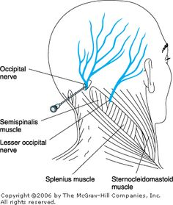
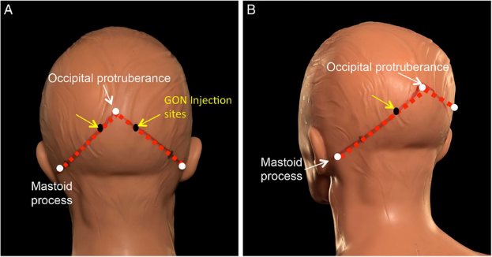
Interventions
GON & LON procedures (Level II)
-LA & steroid injections
-pulsed RF or cryoneurotomy

Slide 27
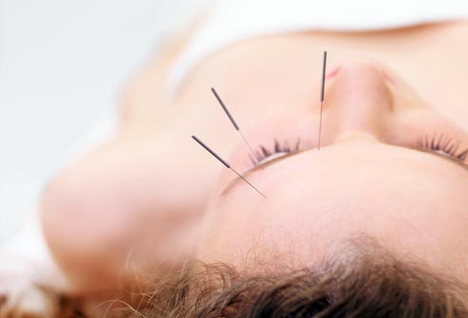
Interventions
Trigger point injections, dry needling
Acupuncture (Cochrane)
-migraine
-TTH

Slide 28
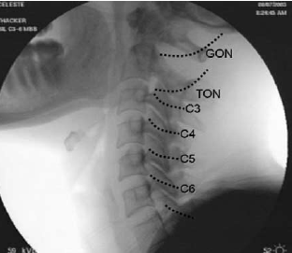
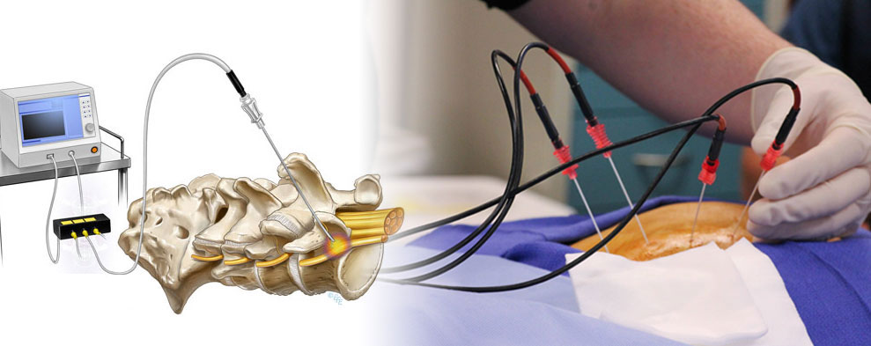
Interventions
C2/3 facet (3rd:TON) procedures
Facet joint injections
Pulsed RF treatments
Thermal RF neurotomies

Slide 29
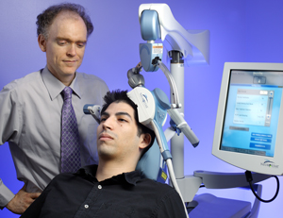
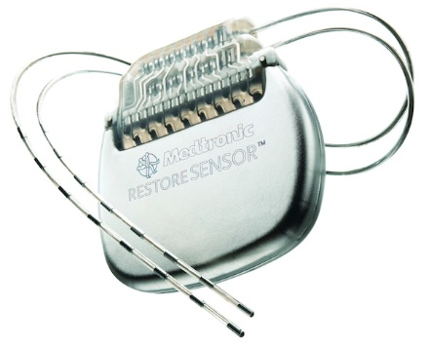
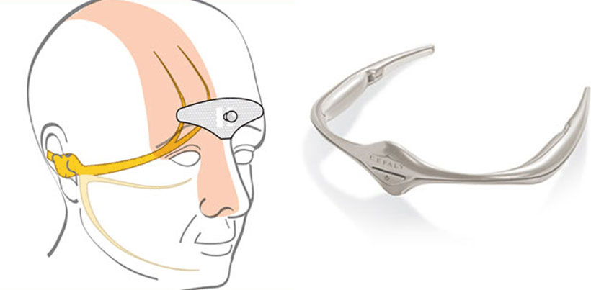
Interventions
Neuromodulation
Cranial TENS (Cefaly)
Transcranial magnetic stimulation
Occipital nerve or field stimulator

Slide 30
Medication overuse headache
Stopping medications is key
Preparation is vital (work, lifestyle)
Realistic expectations (it’s going to be hard)
Psychologist (stress, pain) (key supporters)
Exclude drug dependency or addiction
Headache diary
Optimise precursor headache (prophylaxis)
Treat withdrawal & rebound headache
Prevent relapse (30-50%)
Outpatient vs inpatient
Evers & Jensen EJN 2011

Slide 31
Outpatient plan
(4 weeks)
Optimise precursor headache
-GON blocks, Cefaly, topiramate, Botox
Baseline treatment
-amitriptyline, metoclopramide, prednisolone, lorazepam prn
Taper medications by 10% per week
Rescue plan
-Cefaly, NSAIDs (indomethacin PR), clonidine, antiemetics, lorazepam prn
-nasal oxytocin?
Frequent medical review

Slide 32
Inpatient plan
(5 days)
As per outpatient plan
Abruptly cease headache medications
Baseline: IV low-dose ketamine, IV metoclopramide, IV dexamethasone
Rescue plan
-Cefaly, IV antiemetics, parecoxib, clonidine, nasal oxytocin?
-IV lignocaine

Slide 33
Key messages
CDH is common & crippling
Transformed precursor headache
Medication overuse
Stress
Exclude red flags (MRI)
Headache diary
Optimise precursor headache
Stop analgesics
Multi disciplinary support
Watch closely (relapse rate 30%)

Slide 34
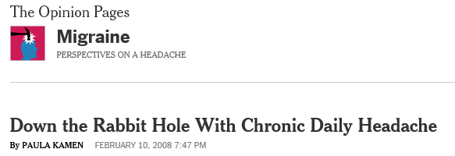


Alice in Wonderland
http://migraine.blogs.nytimes.com/2008/02/10/down-the-rabbit-hole/?_r=0

Slide 35
Primary
Headaches
Tension-type (most common 80%)
Migraine (15%)
-aura (15%)
-without aura) (common migraine) (75%)
Vascular-autonomic (cluster headache) (rare <1%)

Slide 36
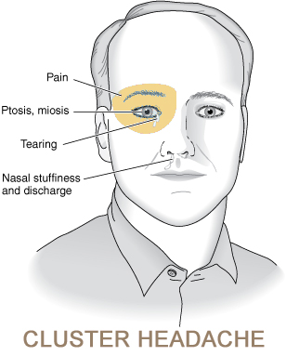
Cluster
headache
(Hemicrania)
Rare (M>F)
Trigeminal-autonomic-vascular
Hypothalamus (‘clock’, early morning)
‘Cluster’ attacks (clusters of time)
Migraine-like (hemicrania)
Trigeminal (periorbital pain)
Autonomic (swelling, tearing, redness)
Restlessness (pacing room at 4am)
Indomethacin
ice-cream headache
suicide headache

Slide 37
History
Character of headache
-worsening, ‘thunderclap’, postural, neurological symptoms, vomiting,
wakes at night
Triggers
-injury, illness, whiplash, stress, medications, diet, sleep, menstrual
Personal & family
-1⁰ family, head injury, sleep apnoea (OSA), patent ductus
-childhood headache or pain, abdominal migraine
Medication & substance use

Slide 38
Secondary
Headaches
Chronic daily headache (transformed)
Medication overuse headache
Cervicogenic headache
Whiplash-associated headache
Occipital neuralgia
Others (e.g. sinus headache)
Pathological ‘red flags’ (T.I.N.T)

