Slide 1
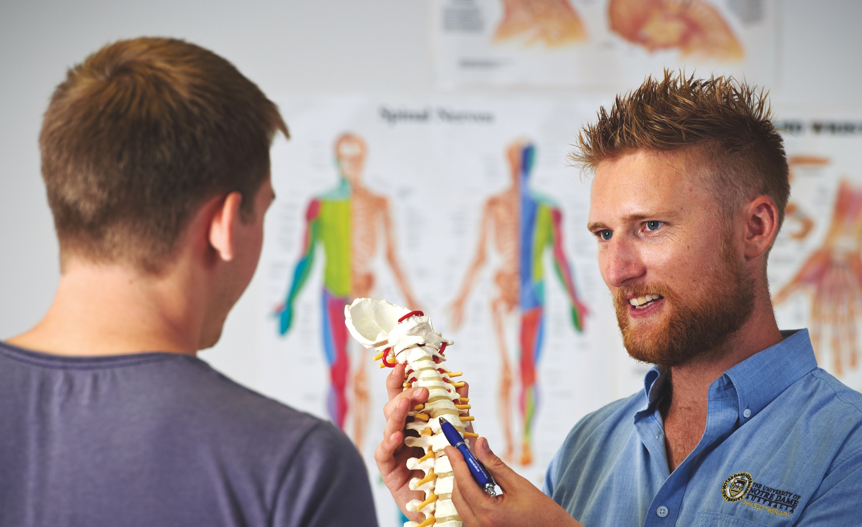
Pain: clinical principles
of physiology & pharmacology MEDI6200
Prof Eric Visser
Fremantle
Broome
Sydney

Slide 2
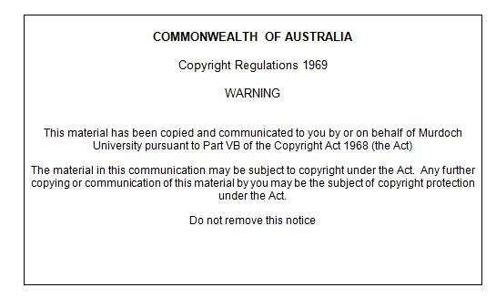
Student Learning Outcomes
Review the physiological mechanisms of pain and describe, in principle, how pain is managed.

Slide 3
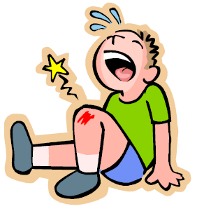
What is pain?
‘Pain is an unpleasant sensory & emotional experience associated
with actual or potential tissue damage’ (IASP 2012)
Pain is generated by the conscious brain in response to perceived
tissue damage
Pain is more than a sensation
Pain is a multidimensional, whole-person experience
Pain always occurs in a ‘context’
Bio-medical-psycho-social-environmental

Slide 4
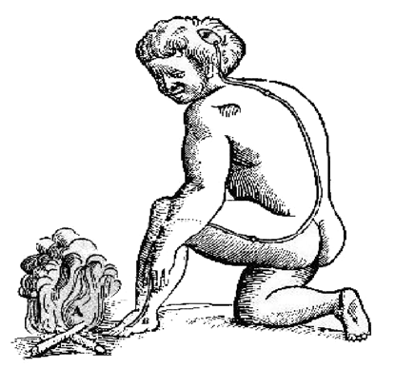
Nociception
‘The process of encoding & transmitting noxious stimuli in the
nervous system’ (IASP 2012)
Converting the ‘energy’ released by tissue damage into signals
in the nervous system
Pain & nociception are not the same
Nociception is ‘sensory processing’ (brain input)
Pain is a sensory & emotional experience (brain output)
Nociception is the main trigger of pain
You CAN experience pain without nociception

Slide 5
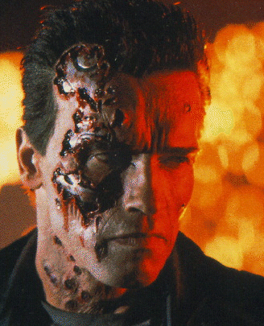
Pain & nociception explained in a movie!
Terminator II-Judgment Day (1991)
John Connor
“Does it hurt when you get shot?”
The Terminator
“I sense injuries” (great definition of nociception)
“The data could be called ‘pain.’ ”

Slide 6
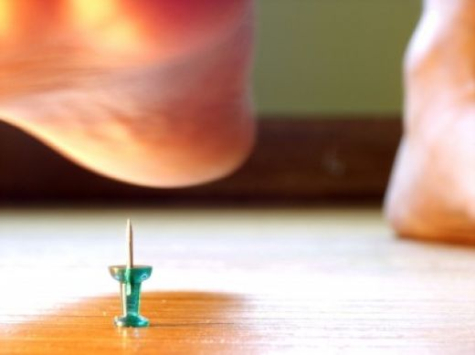
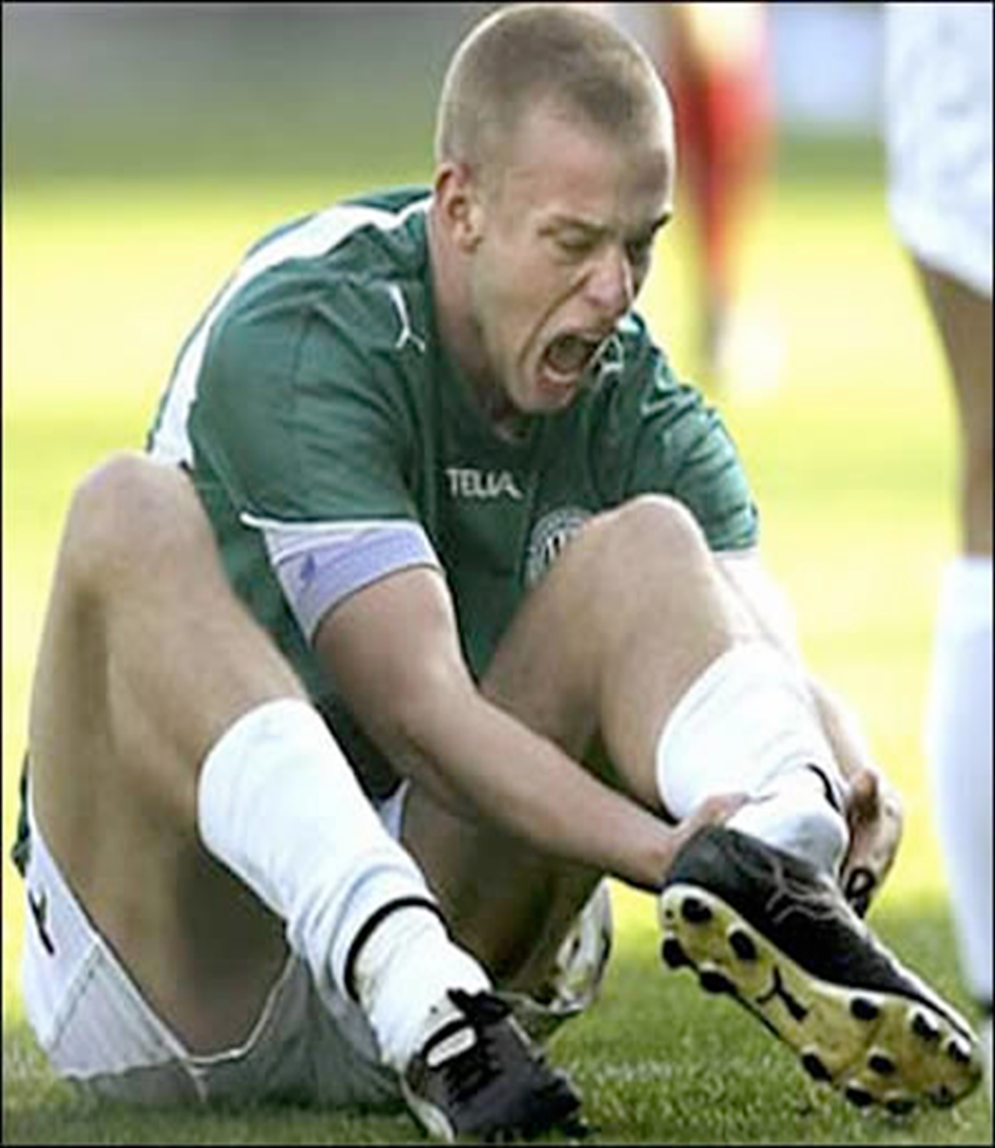
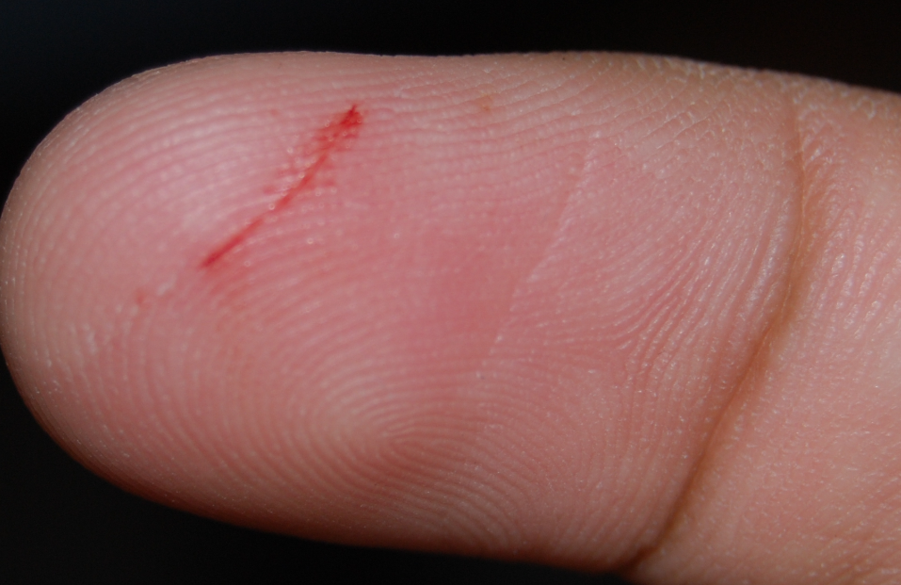
Pain is nature’s tissue-damage ‘alarm’

Slide 7
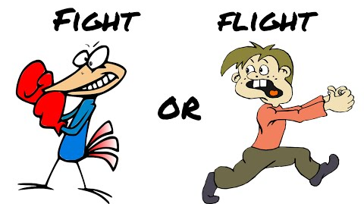
Pain
alarm
Pain ‘motivates’ us to avoid tissue damage in real time
Fight or flight & acute stress responses
Teaches us to avoid similar tissue damage in future (memory)
Pain behaviours
Signals our distress to others

Slide 8
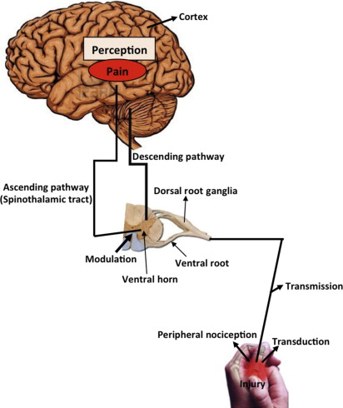
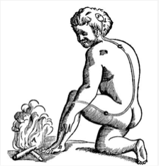
Nociceptive (pain) pathways
Limbic system
http://ars.els-cdn.com/content/image/1-s2.0-S1877117315000046-f01-01-9780128013892.jpg
Brainstem
Dorsal horn

Slide 9
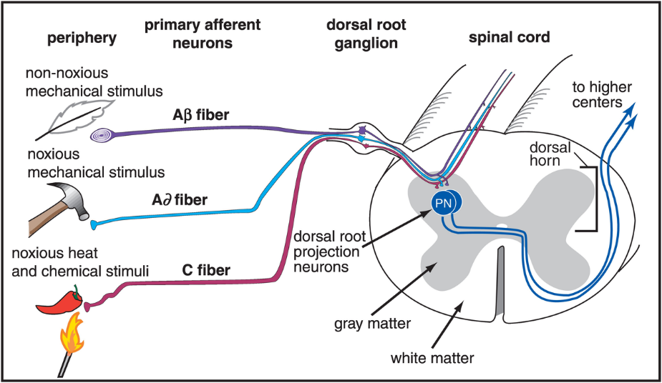
Peripheral
nociception
http://stahlonline.cambridge.org/content/ep4/images/02598fig10_1.png

Slide 10
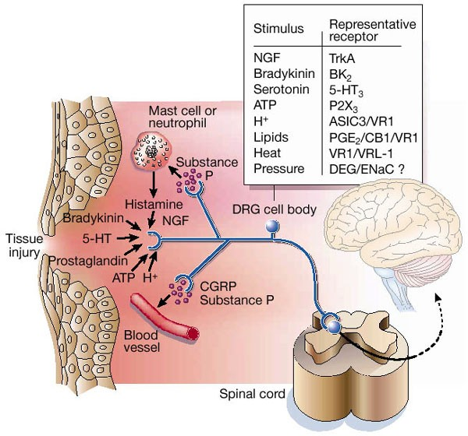
Inflammatory
soup

Slide 11


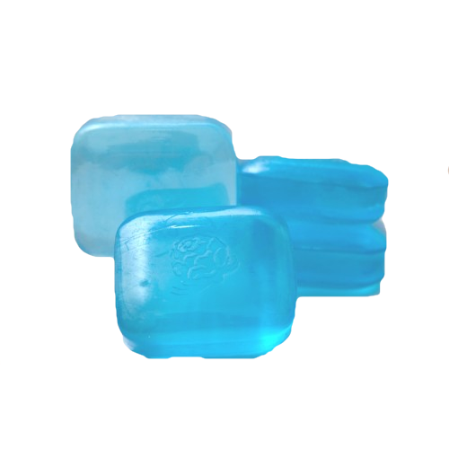

Transduction
Converting the (chemical, thermal, mechanical) energy released by tissue damage into electro-chemical nerve signals
Heat
Acid (H+)
TRPV1
DRG
Capsaicin cream 0.025%
Cold
TRPV8
Menthol gel 2-4%
Mechanical
Bandage, cast, splint

Slide 12
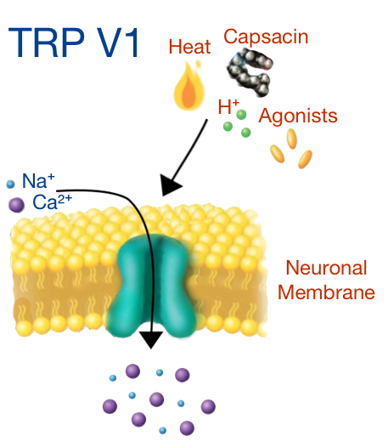
TRPV1
ion channel
transduction
Inflammatory soup
“Pepper”
Capsaicin

Slide 13
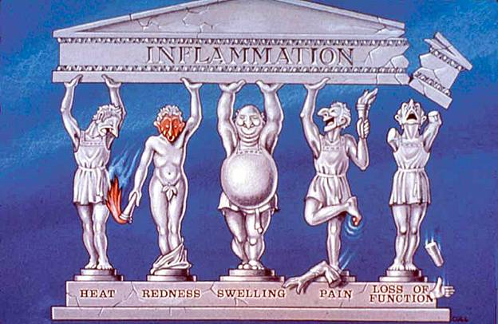
Cyclooxygenase
(COX)
Inflammatory soup
-“stock”
COX 1
-housekeeping
-NSAIDs
COX 2
-spring cleaning
-induced by stress
-COX-2 selective inhibitors

Slide 14
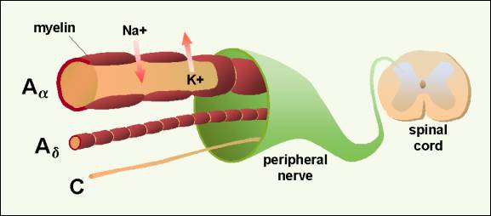
Aδ & C fibres
transmission
Aδ fibres
Thick
Myelinated
Fast
Localised
‘Sharp’
C fibres
Thin
Unmyelinated
Slow
Poorly localised
Dull, aching, burning
http://stahlonline.cambridge.org/content/ep4/images/02598fig10_1.png

Slide 15
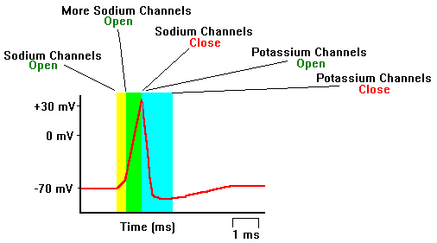
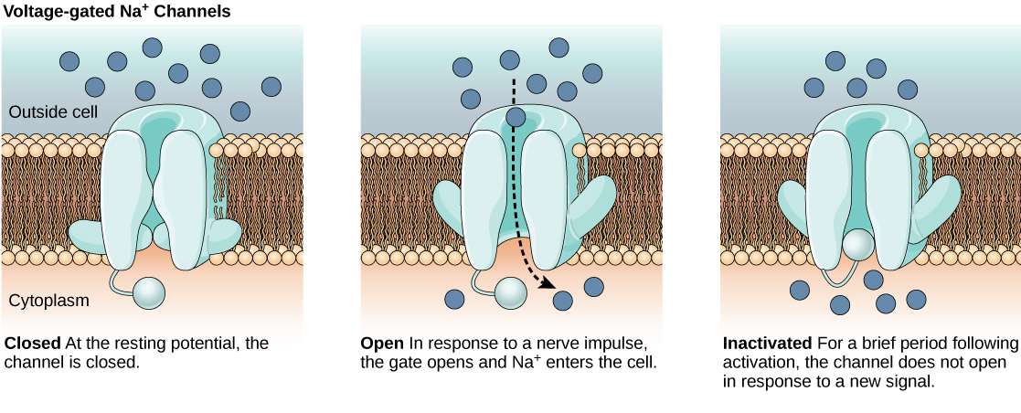
Voltage-gated Na⁺ channels
transmission

Slide 16
Anticonvulsants
Membrane stabilizers
-↓ spontaneous electrical activity (ectopics)
-neuropathic pain
-migraine
Block voltage gated Na ion channels
-carbamazepine
-valproate
-lignocaine
Block specialized calcium ion channels (α2δ subunit)
-pregabalin, gabapentin
Na⁺
DRG
Ca⁺⁺
α2δ
Na⁺
Na⁺

Slide 17
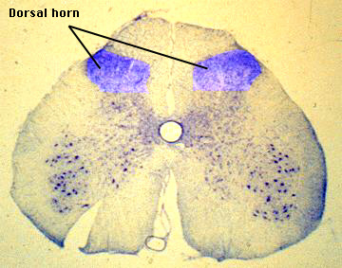
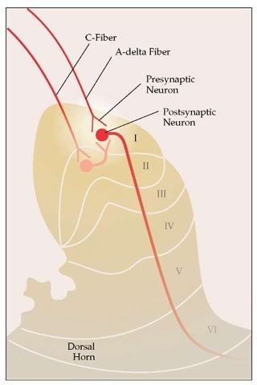
‘CPU’ of nociceptive system
Dorsal horn
modulation

Slide 18
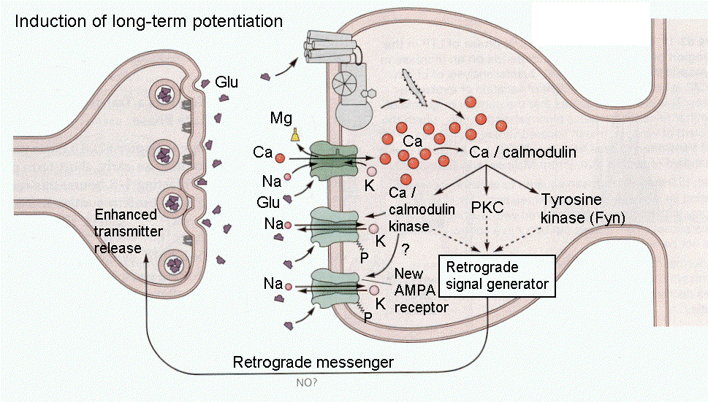
Dorsal horn
first-order synapse
Nuclear
changes

Slide 19
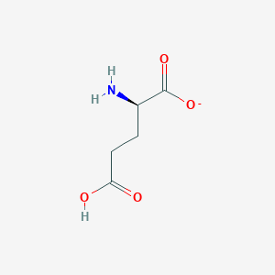
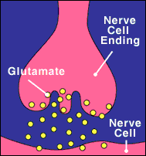
Glutamate
Most abundant neurotransmitter (90%)
Excitatory (neurotoxic in high amounts)
Amplification
Sensitization
Learning
Memory
Wind-up

Slide 20
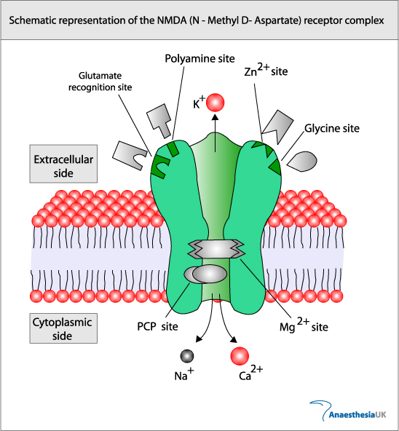
Nervous system’s ‘chemical transistor’ (amplifier)
NMDA
channel
N-methyl-D-asparate
Central sensitization
Memory
Glutamate is ligand
Blocked by ketamine

Slide 21
Central sensitization
amplifier
Increased nociceptive output for a given nociceptive input
Amplifier effect
Capacitance effect
‘memory’
NMDA
1 1 1 1 1 1 1 1 1 1 1 1 1 3Hz
lllllllllllllllllllll 50 Hz
Wind-up
Dorsal horn
Notes:
21

Slide 22

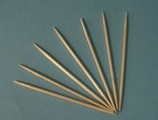

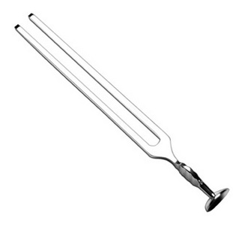
Greek for ‘other pain’
Allodynia is clinical sign of central sensitization
Allodynia
‘touch pain’
If any of these non-painful stimuli feels painful,
you have detected allodynia…
...and therefore central sensitization
Notes:
22

Slide 23


Pain
inhibition
‘flight or fight’

Slide 24
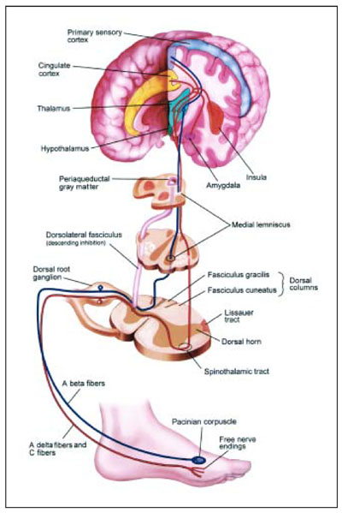
Descending
inhibitory control
Descending inhibition of nociception
Flight (or fight)
Allows us to escape danger
Sitting on our bottoms!
Inhibitory neurotransmitters
-norepinephrine
-serotonin
-endorphins
Antidepressants (tricyclics, NRIs)
Clonidine
Opioids

Slide 25
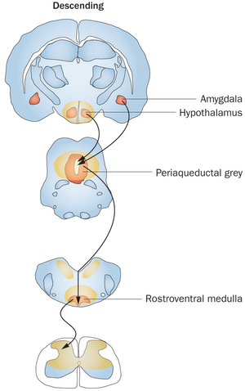
Descending
inhibitory control
NE

Slide 26
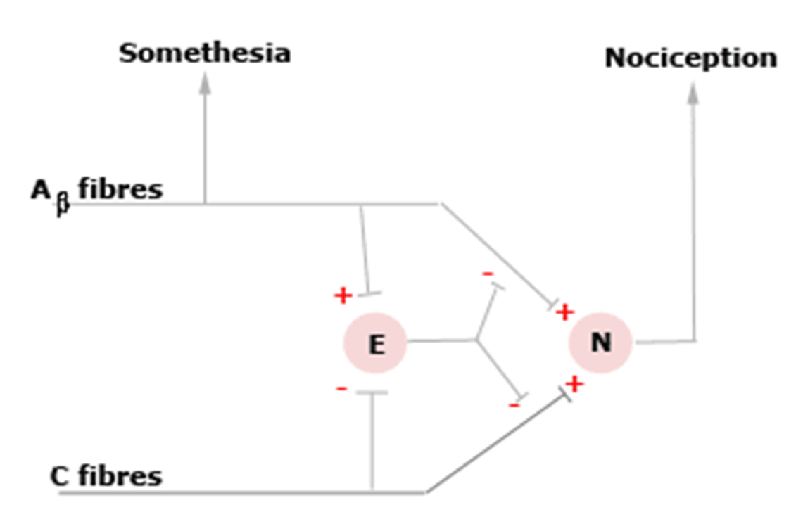
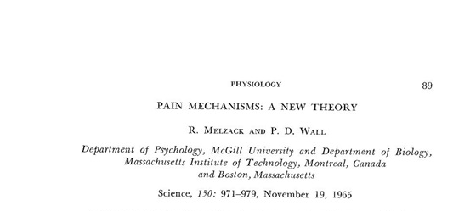
Pain gate
in dorsal horn

Slide 27
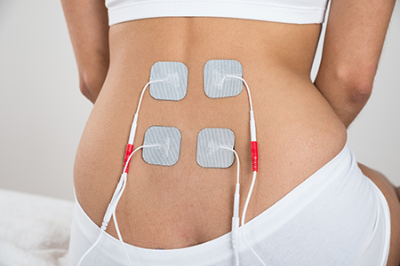
TENS
Analgesia

Slide 28
Nociceptive
(pain)
modulation
Pain
Inhibitory Control
“Damping”
Central
Sensitization
“Amplifier”
Notes:
28

Slide 29
Antidepressants
Neuropathic pain
Multiple receptors
Tricyclic antidepressants (most effective, NNT 3)
SNRIs (duloxetine) (effective, NNT 6)
SSRIs (not effective)
NE is main analgesic neurotransmitter
NE
5HT
αAR
Na⁺
NMDA

Slide 30
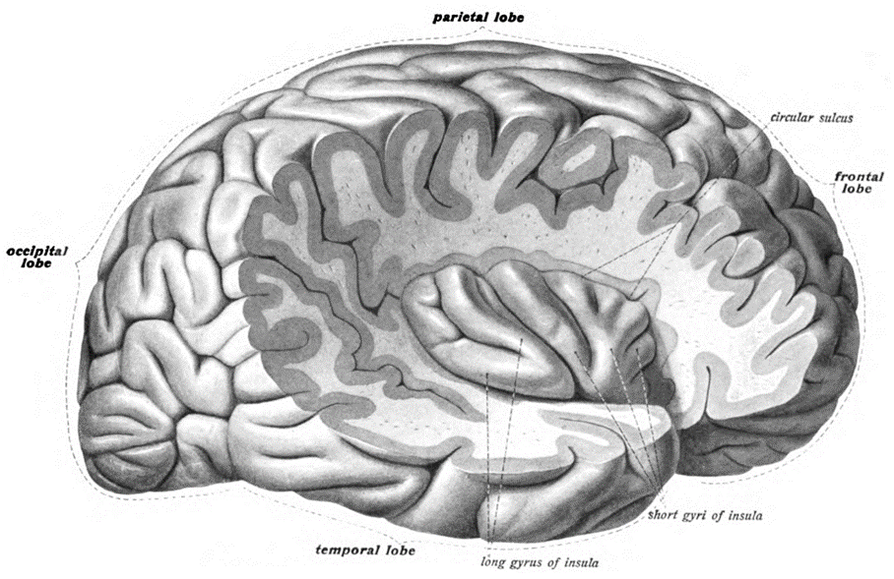
Opioids
mu, delta, kappa, nociceptin receptors
MOP DOP KOP NOP (IUPHAR)
Neuro + endocrine + immune inhibitors
Opioids slow everything down
Analgesia
Side effects
-brain (sedation)
-breathing, coughing
-bowel
-bladder
-immune
OR
OR
OR
OR

Slide 31
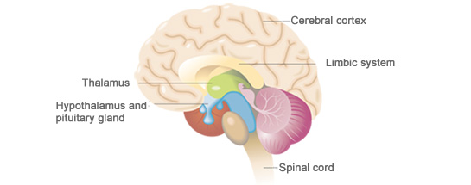
The pain
‘matrix’
Somatosensory cortex
Pre frontal cortex
Amygdala
RAS
The bane of pain is mainly in the brain
Loesser

Slide 32
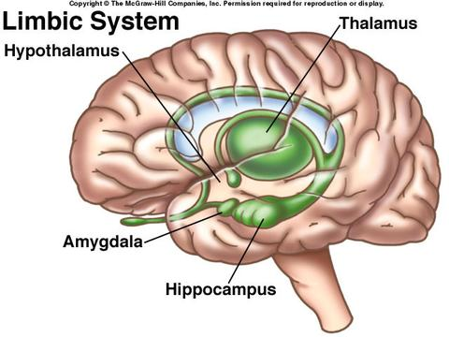

Emotional & autonomic response
Pain ‘relay station’
Autonomic
Cingulate gyrus
Fear & anxiety
panic
Memory of pain

Slide 33

Nociceptive (pain) pathways
Pain
Descending inhibition
DRG
NE
5HT
antidepressants
Na⁺
lignocaine (LAs)
anticonvulsants
TCAs
clonidine
ketamine
AαR
Na⁺
AαR
NMDA
OR
Aδ & C fibres
α2δ
opioids
capsaicin
^{NSAIDs, coxibs}
pregabalin
TRPV1
^{COX}
Dorsal horn
Central sensitization
transduction
transmission
modulation

Slide 34
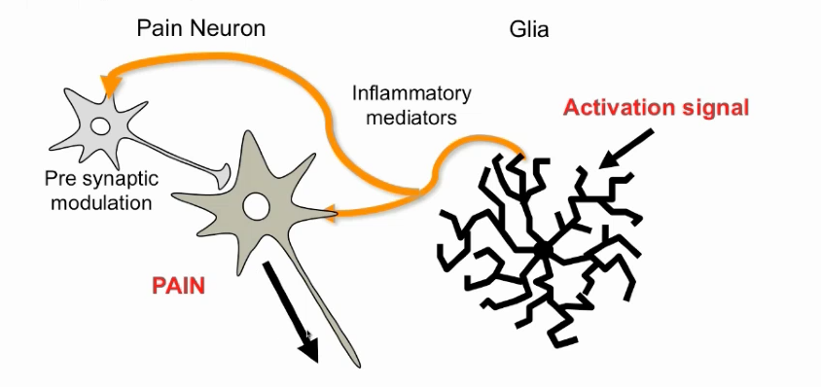
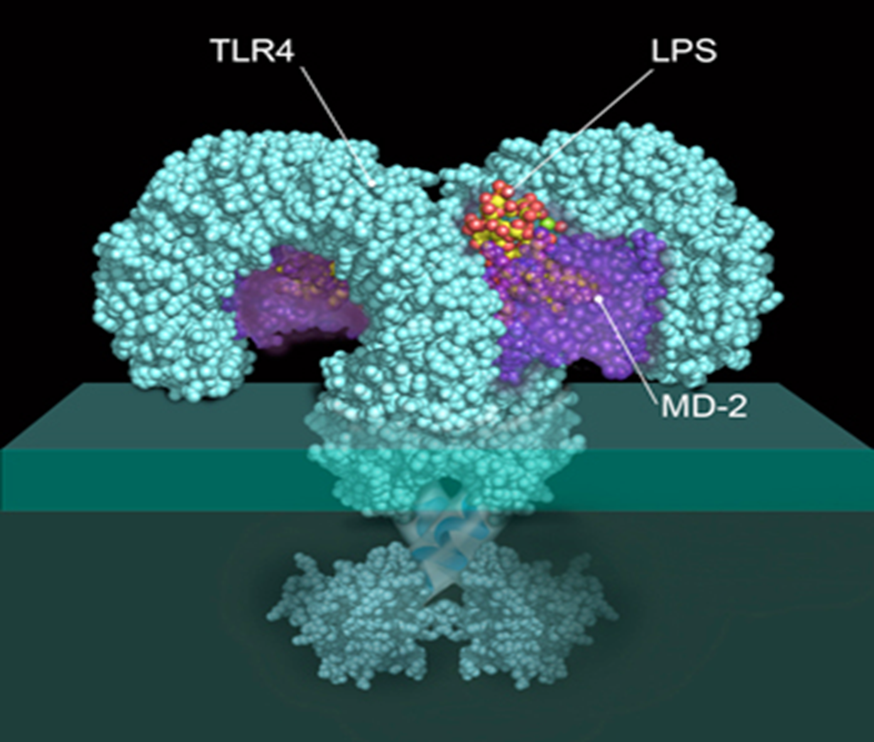
Immune modulation of nociception in the nervous system
Interleukin 1, 6, TNF
Toll-like receptor 4
Notes:
Need this to happen to have chronic pain.

Slide 35

Questions?

